Slide 1
“Do rich countries keep poor countries poor?”
Day 1
Dr Ingrid Harvold Kvangraven King’s College London
Chulalongkorn University, Bangkok December 18th 2024

Slide 2
Today
Day 1
First session
How did rich countries get rich? How does capitalist development happen?
Second session
To what extent is capitalist development possible today? What does contemporary global governance allow?

Slide 3
First… what do you think?
Do rich countries keep poor countries poor? How so? Why not?
How did rich countries become rich, anyway?
Go to mentimeter.com and use access code:
6395 9966

Slide 4
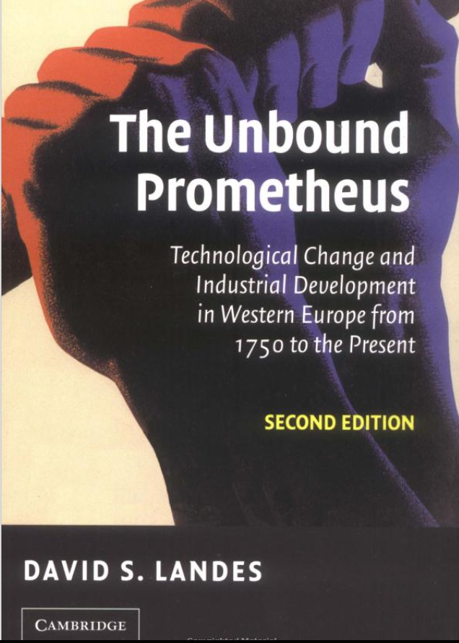
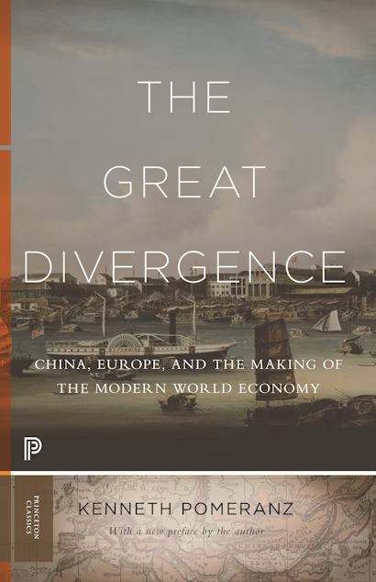
How did rich countries develop? The official story
Capitalism driven by self-interested, rational individuals and scientific advances, obstacles to the development of capitalism are gradually removed, such as political and cultural constraints (Landes, 2006).
Enlightenment values often seen to be foundational to the development of capitalism, as they are perceived to having provided a rational basis for morality, rights such as equality before the law, and progress through scientific and technological advances (Mokyr, 2004).
Low costs of energy sources, abundance of coal in Britain making industrial revolution possible (Allen, 2011; Pomeranz, 2000)

Slide 5
How did rich countries develop? The official story
What’s missing in the official story?

Slide 6
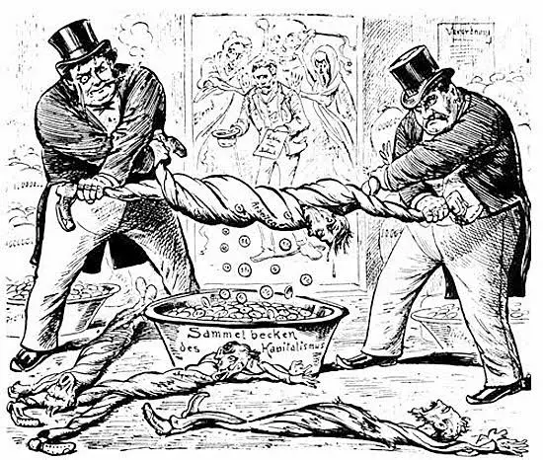
How did rich countries develop? An alternative story
Transformation of social relations, not simply increases in technological advancements and market exchange
Involved primitive accumulation (dispossessing people from their land/livelihoods to make way for capitalist production) & violent creation of a proletariat (Thompson, 1963; Patnaik and Moyo, 2011)

Slide 7
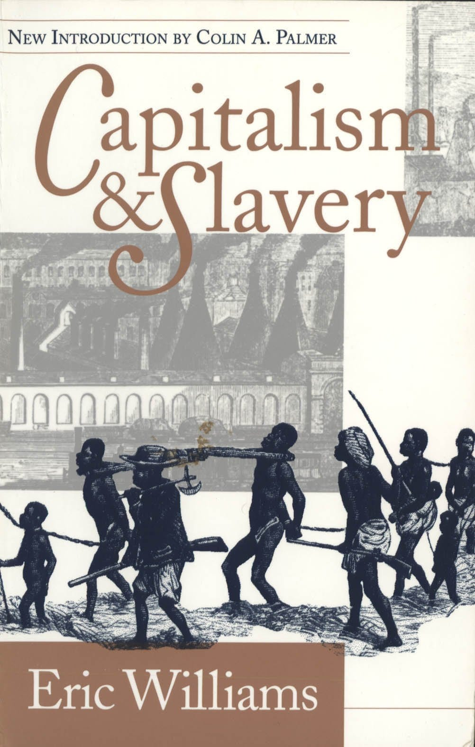
How did rich countries develop? An alternative story
Transformation of social relations, not simply increases in technological advancements and market exchange
Colonialism, the Transatlantic Slave Trade, and patriarchy also shaped the nature of capitalism’s development (Du Bois, 1935, Fed Federici, 2004; Patnaik, 2018; Sen and Marcuzzo, 2017; Williams, 1944).

Slide 8
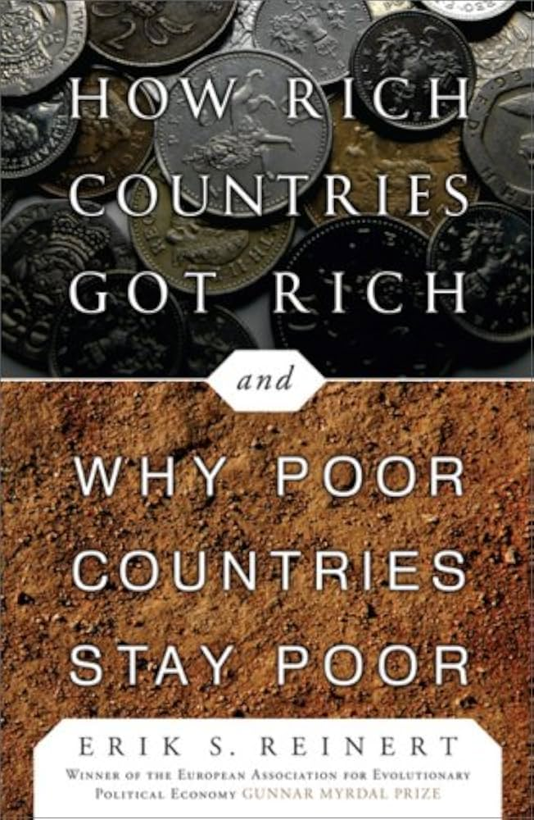
How did rich countries develop? An alternative story
State managed interventions to boost competitiveness
England 1500s-1600s: protectionist policies in order to catch up/compete with textile production in Holland and Italy (Reinert, 2007)
US 1700s: Hamilton also implemented protectionist policies to enhance competitiveness
1818: Ricardo publishes thesis on comparative advantage, arguing that all countries should pursue free trade
1800s: List’s response to Ricardo: “Kicking away the ladder”

Slide 9
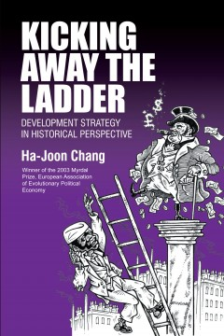
How did rich countries develop? An alternative story
State managed interventions to boost competitiveness
East Asian ‘miracle’ countries borrowed from these early experiences & with fiscal support from US (Amsden, 1992; Wade, 1990; Sial 2018);
This is ignored in the ‘official story,’ where East Asian development is presented as market-based (Amsden, 1994; Lin and Chang, 2009)
Since 1980s: again, “Kicking away the ladder” (Chang, 2002)

Slide 10
The problem with the official story
It is Eurocentric (Amin, 1988):
Eurocentrism: The idea that capitalism developed in Europe endogenously, in a rational manner, and that all other countries can follow the same path.
Ignores the global unequal dynamics that sustained the development of capitalism
Ignores the fact that capitalism evolved differently in the global South (Sanyal, 2007)
Ignores the fact that countries in the global South were structured to export raw materials, for which there are falling terms of trade (Prebisch)
Ignores the fact that countries in the global South don’t have colonies (or other enormous sources of wealth) to sustain their industrialisation paths

Slide 11
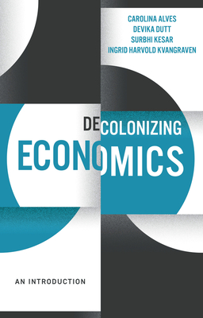
The problem with the official story
Important today because:
It underlies mainstream economic thinking (Dutt et al. 2025)
More importantly: It underlies global economic policy, justifying free-market policies of international organisations
This is relevant for policies in both the global South and North

Slide 12
The problem with the official story
Given the discussion about how rich countries developed, what would be needed for countries in the Global South to develop?
What are the obstacles to development in the global South?

Slide 13
Global governance and the (im?)possibility of development today
Day 1
“Do rich countries keep poor countries poor?”

Slide 14
Global governance architecture: trade
Let’s consider the trade architecture of today and how it evolved.
Is it Ricardian or Listian?

Slide 15
Global governance architecture: trade
International Trade Organization (ITO) 1944 (during Bretton Woods conference) failed, but we got GATT (General Agreement on Trade and Tariffs) in 1947
→ Most Favoured Nation (MFN) → No effective enforcement mechanism
1960s Kennedy Round (anti-dumping)
1970s Tokyo Round (non-tariff barriers)
1995: World Trade Organization
Since 2001 Doha Development Round → Deadlock → Proliferation of regional agreements (which often go further than WTO)

Slide 16
Global governance architecture: trade
World Trade Organization
From Most Favoured Nation to National Treatment
1) Agreement on Trade Related Aspects of Investment Measures (TRIMS)
e.g. involves (eventual) bans on local content, export requirements, bans requirements on public agencies to procure goods from local suppliers
2) Agreement of Trade Related Aspects of Intellectual Property Rights (TRIPS)
Establishes 20 year patents on intellectual innovation. Meant to also include technology transfer to Global South (but this is not enforceable).
Recall TRIPS Waiver for COVID vaccines
3) General Agreement on Trade in Services (GATS)

Slide 17
Global governance architecture: trade
Dispute Settlement Mechanism (DSM)
WTO not just about tariffs, also differences in regulations and standards (tax systems, food safety rules, environmental regulations, industrial promotion policies)
Examples of DSM cases:
European ban on hormone-treated beef in the 1990s
Automotive industry promotion programs in India, Indonesia, and China
Credit subsidies for the aircraft industry in Brazil
Japan’s tax regime was found at fault because the distilled liquor shochu was taxed at a lower rate than imported vodka, whiskey, or brandy

Slide 18
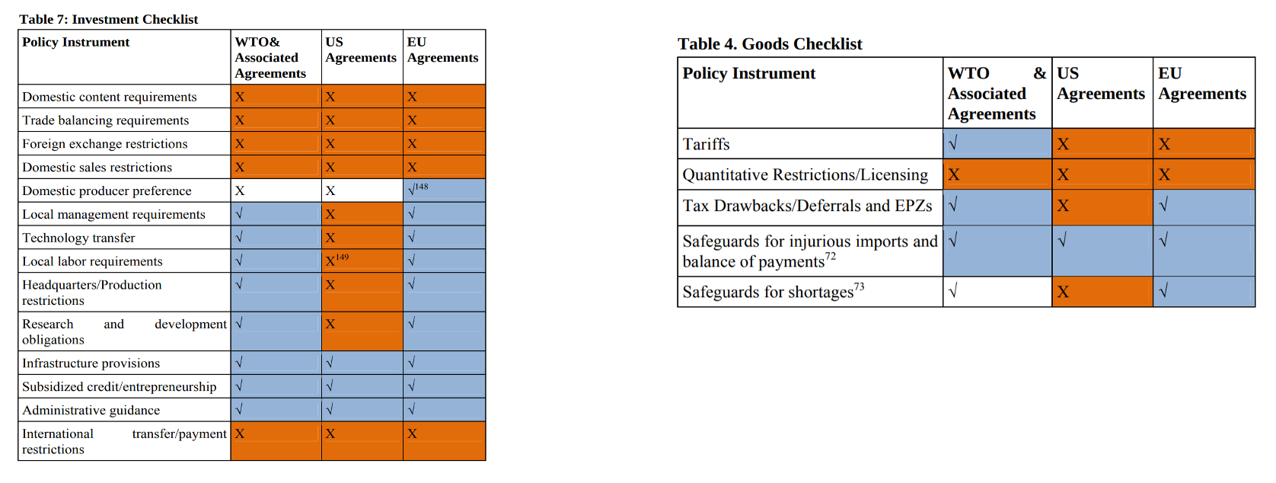
Global governance architecture: trade
Proliferation of regional agreements
Has led to further restrictions on policy space (Thrasher and Gallagher, 2010)

Slide 19
Global governance architecture: finance
Let’s consider the financial architecture of today and how it evolved (Dr Sial will return to this)

Slide 20
Global governance architecture: finance
Bretton Woods Institutions IMF and the World Bank (1944)
Originally to provide short-term loans in crises (IMF) and re-build Europe after World War II (World Bank)
Structural Adjustment Programmes of 1980s and Poverty Reduction Strategy Papers (PRSPs) of 1990s involved a series of conditionalities for Global South countries (liberalise, privatise, deregulate)
Meanwhile, the US has veto power in both institutions
Increasingly, power is moving from UN institutions (such as UNCTAD) to the Bretton Woods Institutions and/or the G20

Slide 21
Attempts at reform of the global financial architecture
2008 crisis demonstrated weakness of US
China and others pushing for voting reform in IMF/World Bank
but only marginal improvements, see Wade’s “The Art of Power Maintenance: How Western States Keep the Lead in Global Organizations”
“New Development Bank” (BRICS bank)
but not (yet) a serious competitior/alternative to World Bank/IMF

Slide 22
Time for a (new) New International Economic Order?

Slide 23
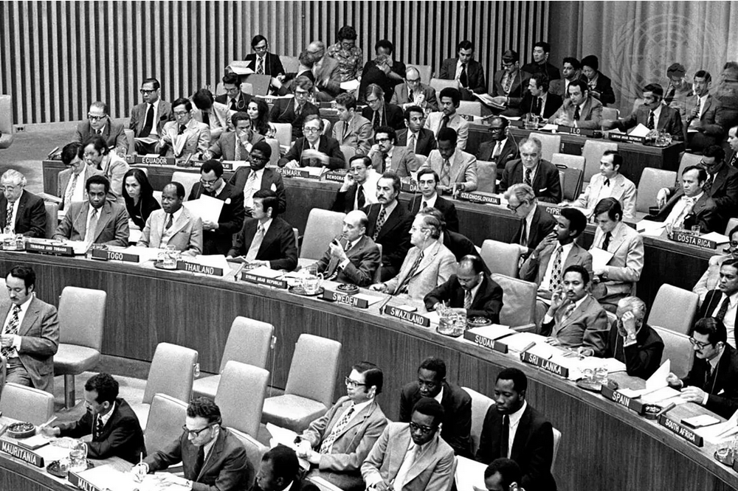
Time for a (new) New International Economic Order?
The original New International Economic Order (NIEO) emerged at the end of the Bandung era, UN resolution passed in 1974
Main aims:
sovereign equality and the right of self-determination, especially when it comes to sovereignty over natural resources
need for a new commodity order through international commodity agreements and a common fund for commodity price stabilisation
However, it was never made into reality as in the 1970s capitalism entered into a structural crisis
Why did it fail? Complicated question… (Amin, 1984, Benjamin, 2018)

Slide 24
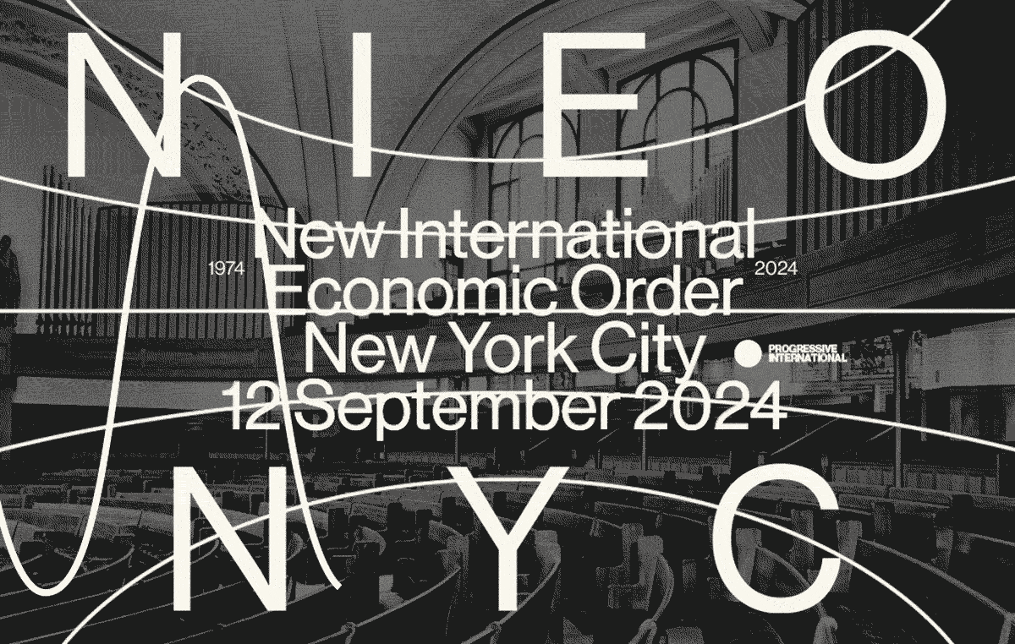
Time for a (new) New International Economic Order?
Again, there are calls for a ‘new’ NIEO, but with few Global South countries supporting it (Progressive International)
Some degree of turn away from multilateralism in the West (Hopewell, 2024)?

Slide 25
So, back to our original question…
“Do rich countries keep poor countries poor”?

Slide 26
Do rich countries keep poor countries poor?
On the one hand, yes: rich countries dominate international institutions that restrict policy space of countries of the global South
On the other hand: it’s complicated, because how would countries in the global South develop along the lines of the global North, even under a new NIEO?
One the third hand: no, not if we consider the class alliances that support global capital (following Amin 1984 and others)

Slide 27
Thank you

Slide 28
References
Allen, R. C. (2011). Global Economic History: A Very Short Introduction. New York, NY: Oxford University Press.
Amin, Samir. 1984. “Self-Reliance and the New International Economic Order”. In Herb Addo (Ed) Transforming the world economy? 9 critical essays on the new international economic order. London : Hodder and Stoughton in association with the United Nations University.
Amin, S. (1988). Eurocentrism: Modernity, Religion, and Democracy. New York: Monthly Review Press.
Amsden, A. 1992. Asia's Next Giant: South Korea and Late Industrialization. Oxford: Oxford University Press.
Amsden, A. 1994. “Why isn't the whole world experimenting with the East Asian model to develop? Review of the East Asian miracle.” World Development 22(4): 627-633.
Benjamin, Bret. 2018. “Developmental Aspiration at the End of Accumulation: The New International Economic Order and the Antinomies of the Bandung Era.” Mediations 32(1):37-70.
Chang, H.J. 2002. Kicking away the Ladder: Development Strategy in Historical Perspective . London: Anthem Press.
Du Bois, W. E. B. 1935. Black reconstruction in America. Atheneum.
Dutt, D., C. Alves, S. Kesar and I.H. Kvangraven. 2025. Decolonizing Economics – An Introduction. London: Polity Press.
Federici, Silvia. 2004. Caliban and the Witch: Women, the Body and Primitive Accumulation. Autonomedia.
Hopewell, K. 2024. “The (surprise) return of development policy space in the multilateral trading system: what the WTO Appellate Body blockage means for the developmental state.” Review of International Political Economy 31(4): 1245-1270.
Landes, David S. 2006. “Why Europe and the west? Why not China?” Journal of Economic Perspectives 20(2):3–22.
Lin, J. and H.J. Chang (2009). “Should Industrial Policy in Developing Countries Conform to Comparative Advantage or Defy it? A Debate Between Justin Lin and Ha-Joon Chang.” Development Policy Review 27(5): 483-502.
Mokyr, Joel. 2004. The gifts of Athena: Historical origins of the knowledge economy. Princeton, NJ: Princeton University Press.
Patnaik, Utsa. 2018. “India’s global trade and Britain’s international dominance .” In Sunanda Sen and Maria Cristina Marcuzzo (Eds) The Changing Face of Imperialism: Colonialism to Contemporary Capitalism. Oxford: Routledge. pp. 201-225.
Patnaik, Utsa and Sam Moyo (2011). The Agrarian question in the neoliberal era: Primitive accumulation and the peasantry. Pambazuka Press, an imprint of Fahamu, and the Mwalimu Nyerere Chair in Pan-African Studies, University of Dar es Salaam.
Pomeranz, Kenneth L. 2000. The great divergence: Europe, China, and the making of the modern world economy. Princeton, NJ: Princeton University Press.
Reinert, Erik. 2007. How Rich Countries Got Rich and Why Poor Countries Stay Poor. New Delhi: Anthem Press.
Sanyal, Kalyan. 2007. Rethinking capitalist development: Primitive accumulation, governmentality and post-colonial capitalism. New Delhi: Routledge.
Sen, Sunanda and Cristina Marcuzzo. 2017. The Changing Face of Imperialism Colonialism to Contemporary Capitalism. London: Routledge.
Sial, Farwa, 2018. "Historicising the Aid Debate: South Korea as a Successful Aid Recipient.” Developing Economics.
Thompson, E.P. 1963. The Making of the English Working Class. New York: Vintage Books.
Thrasher, R.D. and K. P. Gallagher. 2010. “21st Century Trade Agreements: Implications for Development Sovereignty.” Denver Journal of International Law & Policy 38(2)..
Wade, R. 1990. Governing the Market: Economic Theory and the Role of Government in East Asian Industrialization. Princeton University Press.
Wade, R. 2013. “The Art of Power Maintenance: How Western States Keep the Lead in Global Organizations.” Challenge 56(1): 5-39.
Williams, E. 1994[1944]. Capitalism and slavery. Chapel Hill, NC: University of North Carolina Press.

Slide 29
Set up mentimeter:
https://www.mentimeter.com/app/presentation/almspxdsi8duc6ewkno249v7ocsw3cbo/edit?question=t7hf99wk6ohz

