Slide 1

Charles Abugre
SOVEREIGN DEBT AND DEVELOPMENT

Slide 2
OUTLINE
Glossary
Role of Debt in Development
History of Debt and Development - Foundations
Problem in Debt in Development
  Global debt growth
  Changing structure
  Distress
  Drivers
  Social cost
Debt Restructuring
Amnesties

Slide 3
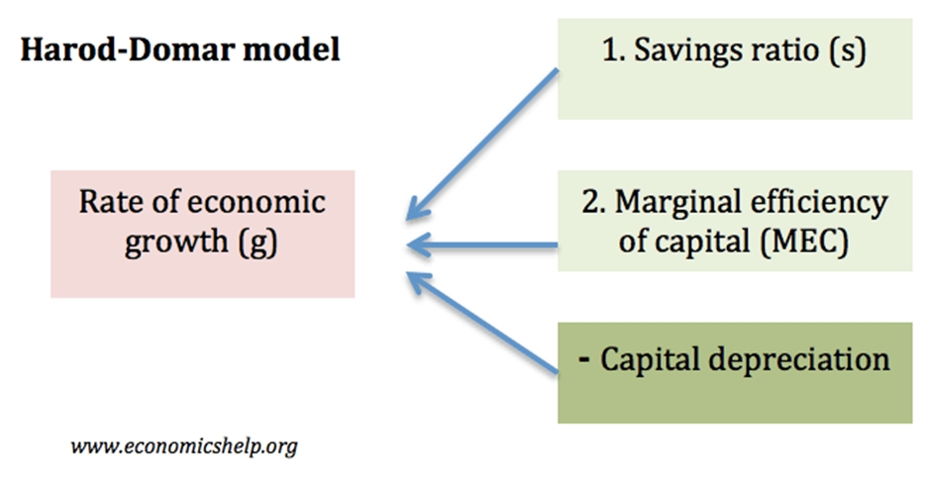
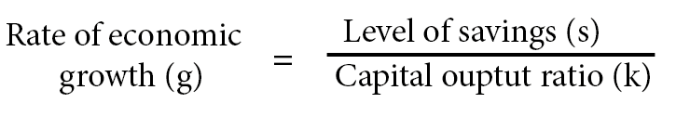
Financing Gap Models – Machines and low savings the constraining elements of development

Slide 4
The Depression and the large number of underemployed rural people in poor countries motivated Sir Arthur Lewis to suggest a "surplus labor" model in which only capital was a constraint. Lewis suggested that building factories would soak up this labor without causing a decline in rural production.
The Soviet experienced inspired the ICOR. N.A. Kovalevskii, the editor of Planned Economy, in March of 1930used the ICOR to project Soviet growth exactly the way that development economists were goingto use it from the 1950s through the 1990s.

Slide 5
The early development economists thought that poor countries were so poor they had little hope of increasing their saving. You have a "Financing Gap" of 8 percent of GDP between the required investment (12 percent of GDP for 3 percent GDP growth) and the current 4 percent of GDP level of national savings. So Western donors should fill the "Financing Gap" with foreign aid, which will make the required investment happen, which in turn will make the target output
growth happen.
From aid (grants, to soft loans to commercial loans)
The Ghost of the Financing Gap, Easterly 1997, World Bank

Slide 6
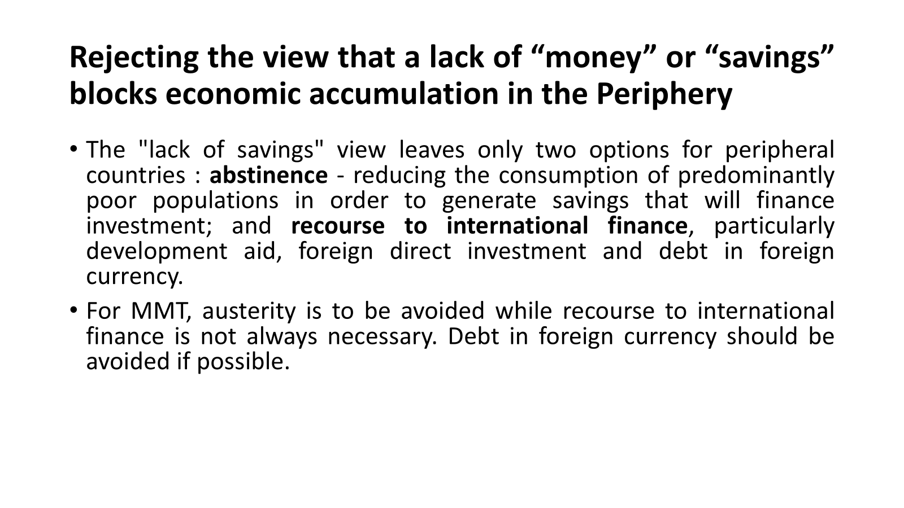

Slide 7
Rejecting the “lack of money” and “lack of savings” views.
The government deficit does not reduce non-government sector savings. On the contrary, it increases the net financial assets of the non-government sector.
Indeed: Government sector balance (Spending – Taxes) = non-government sector balance (domestic net private savings + external net savings)
Developing countries are not constrained by a "lack of money" or a “lack of savings ": “[C]redit money is the key element that frees investment from savings and which makes capital accumulation possible." (Wray 1990, p. 63). See the economic development of Southeast Asian countries (Werner 2005) or even that of West Germany after 1945 (Dullien 2009).

Slide 8
Clarifying development options (2)
Dependence on foreign finance as a Ponzi scheme:
“[T]he Domar conditions for a sustained long-term development strategy based on external financing, on sustained positive net resource transfers, are the precise equivalent of the conditions required for a successful Ponzi financing scheme. […] However, no such scheme in history has ever been successful: they are bound to fail, eventually, because of the increasing size of the net debt stock of the operator of the scheme. On the other hand, if the rate of interest on foreign lending is greater than the rate of increase of foreign lending, then the system is absolutely unstable and cannot be sustained on even a short-term basis.” (Kregel 2006, p.20)

Slide 9
From aid to Loans

Slide 10
Total Debt, Developed and Developing countries, 1960-2017 - volumes

Slide 11
Global Debt, 1960-2017

Slide 13
Not about volume only

Slide 14
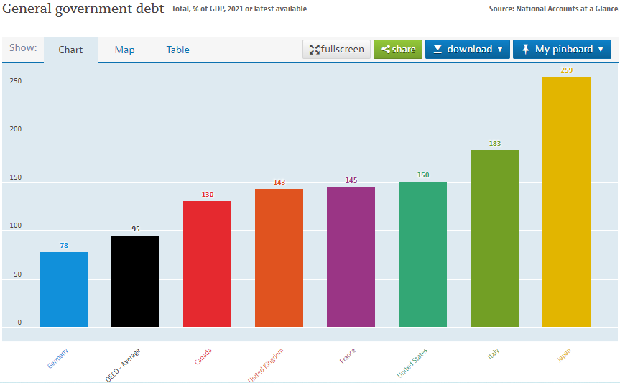
The sovereign debt/GDP ratio in OECD countries

Slide 15
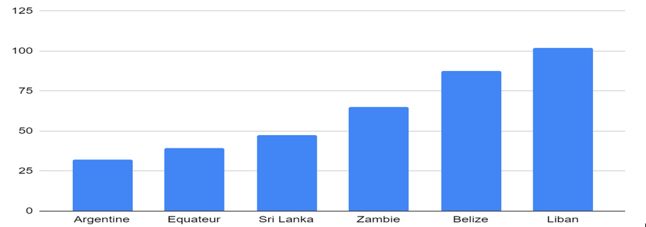
The sovereign debt/GNI ratio for defaulters (2021)

Slide 16
The proportion of LLMICs in Debt distress has soared (IMF DSA)

Slide 17
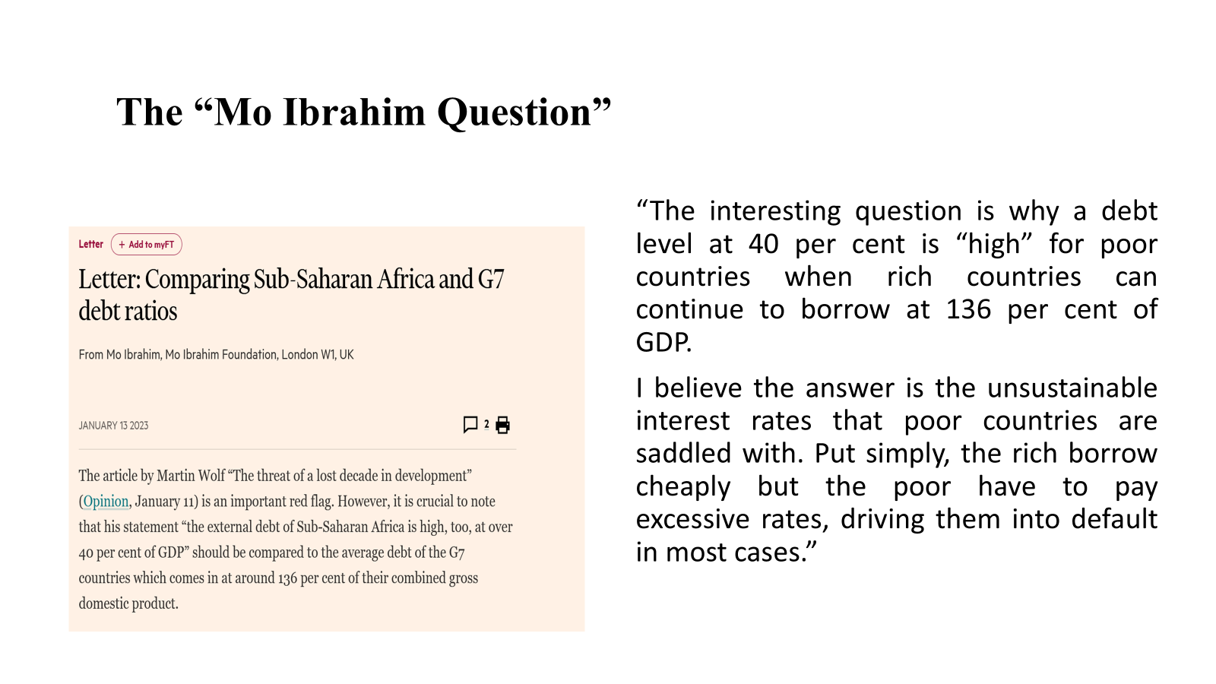

Slide 18
DRIVERS

Slide 19
Keynes described credit as “the pavement along which production travels; and the bankers, if they knew their duty, would provide the transport facilities to just the extent that is required in order that the productive powers of the community can be employed to full capacity.”23
Ideally, bankers and financiers would use their powers to pump productive credit into the economy: to help ensure full employment, efficient use of resources and socially desired growth
But if they are more interested in making a quick buck, they use credit and debt instruments as just another financial asset to play with.
Debt - of countries, businesses and households - has increasingly become a tradable asset in international markets. Private and institutional investors increase their rentier incomes by speculating on the future value of these assets and by exploiting the lack of international regulation for sovereign debt restructurings to hold entire countries to ransom for full repayment of the nominal value of debt, bought at large discounts.

Slide 20
Income concentration and tax shifting

Slide 21
The Global Financial Crisis and Private debt
The global context: Private credit creation out of control
Global debt stocks amounted to $213 trillion at the end of 2017, up from $152 trillion in 2008 and jus below $16 trillion in 1980. As a share of global GDP, global debt rose to 262 per cent in 2017, compared to 240 per cent at the onset of the GFC and 140 per cent in 1980. Much of this extraordinary increase was driven by the accumulation of private debt, which rose more than 12-fold since the early 1980s to account for more than two thirds of total global debt stock in 2017. Public debt also increased substantially, doubling in the decade following the crisis to reach 84 per cent of global GDP
The explosion of global private debt since the early 1980s, both in absolute terms as well as relative to GDP, reflects more than three decades of financial deregulation and heavily privatized credit creation and financial intermediation in developed economies.
The share of private debt in their GDP rose from 115 per cent in 1980 to well over 200 per cent by 2017. By contrast, the share of public debt in developed countries’ GDP remained fairly stable throughout the 1980s and 1990s, at 50–70 per cent, increasing markedly only in the aftermath of the GFC to over 100 per cent

Slide 22
Deregulation
Beginning with the Deposit Institutions Deregulation and Monetary Control Act of 1980 in the United States, financial deregulation resulted in several waves of bank consolidation creating “too big to fail”banks in financial centres, and a gradual shift towards market-based finance. By 1989, the Delors Report on economic and monetary union in the European Community called for “the complete liberalization of capital transactions and full integration of banking and other financial markets” (Committee for the Study of Economic and Monetary Union, 1989: 15) in a bid to step up the creation of European equivalents to United States “mega-banks” and to facilitate the growth of non-bank financial markets in Europe

Slide 23
Deregulation (2) – the rise of innovative and speculative instruments
The repeal of the Glass-Steagall Act in the United States in 1999 – allowing banks to integrate their commercial lending and deposit roles with their more speculative investment activities (so-called universal banking) – completed the dismantling of any serious regulatory constraints on the new global financial system of mega-banks operating alongside fast-proliferating networks of non-bank financial intermediaries. The latter have come to be known as the “shadow-banking” sector due to the deep opacity of its financial transactions (Dymski, 2018; see also chapter II of this Report).
“Innovative” instruments – securitization, special putpose vehicles, derivatives - that increased the availability of credit by converting non-tradable financial assets into tradable securities, transforming liability risks into financial instruments and diversifying individual creditor risks

Slide 24
Failure of re-regulation
With attempts at reregulation in the aftermath of the 2008 crisis remaining largely ineffective (TDR 2015; Engelen, 2018), shadow banking or “the subterranean credit system” of broker-dealers, money market mutual funds, hedge funds and insurance corporations among others (Guttman, 2018: 26), has expanded unabated. Since the GFC, non-bank financial intermediation has grown twice as rapidly as conventional and public banking, such that its share of total global financial assets (48.2 per cent) is now larger than that of commercial banks and public financial institution

Slide 25
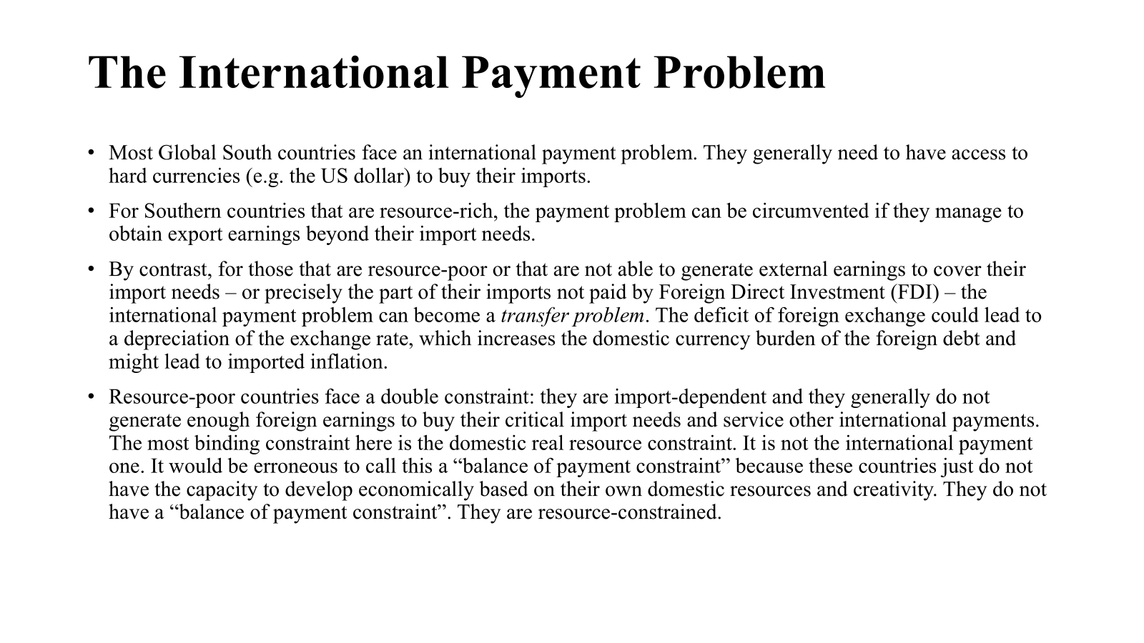

Slide 26
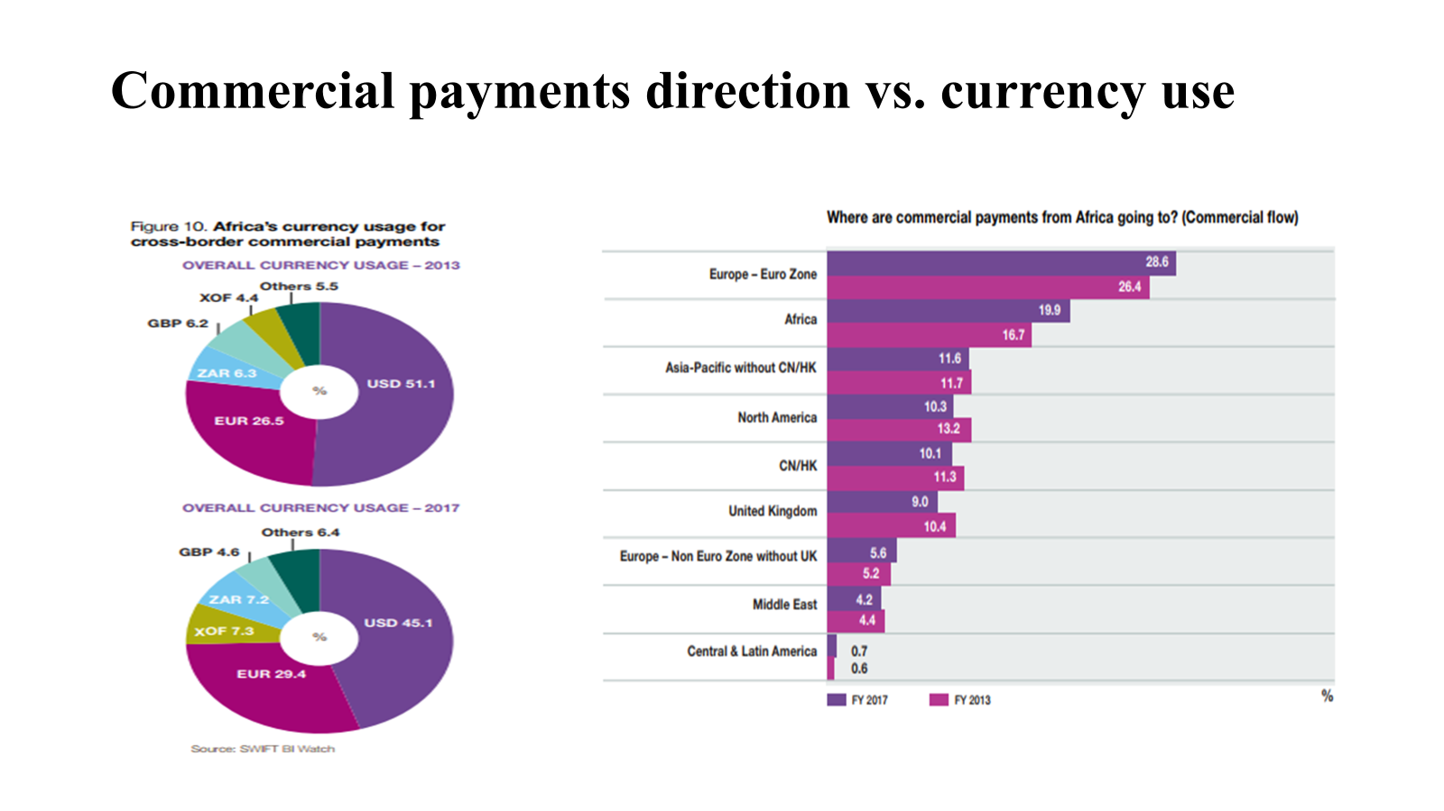

Slide 27
IMPACTS

Slide 28
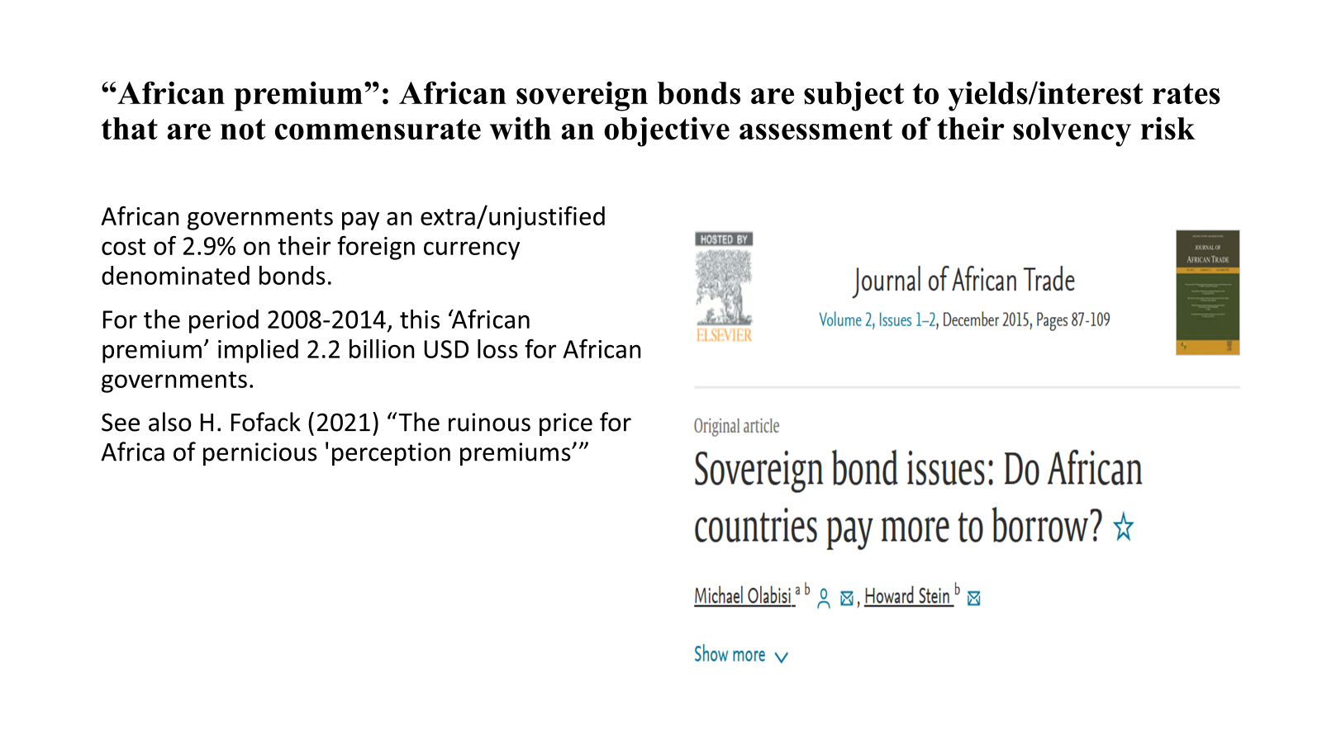

Slide 31
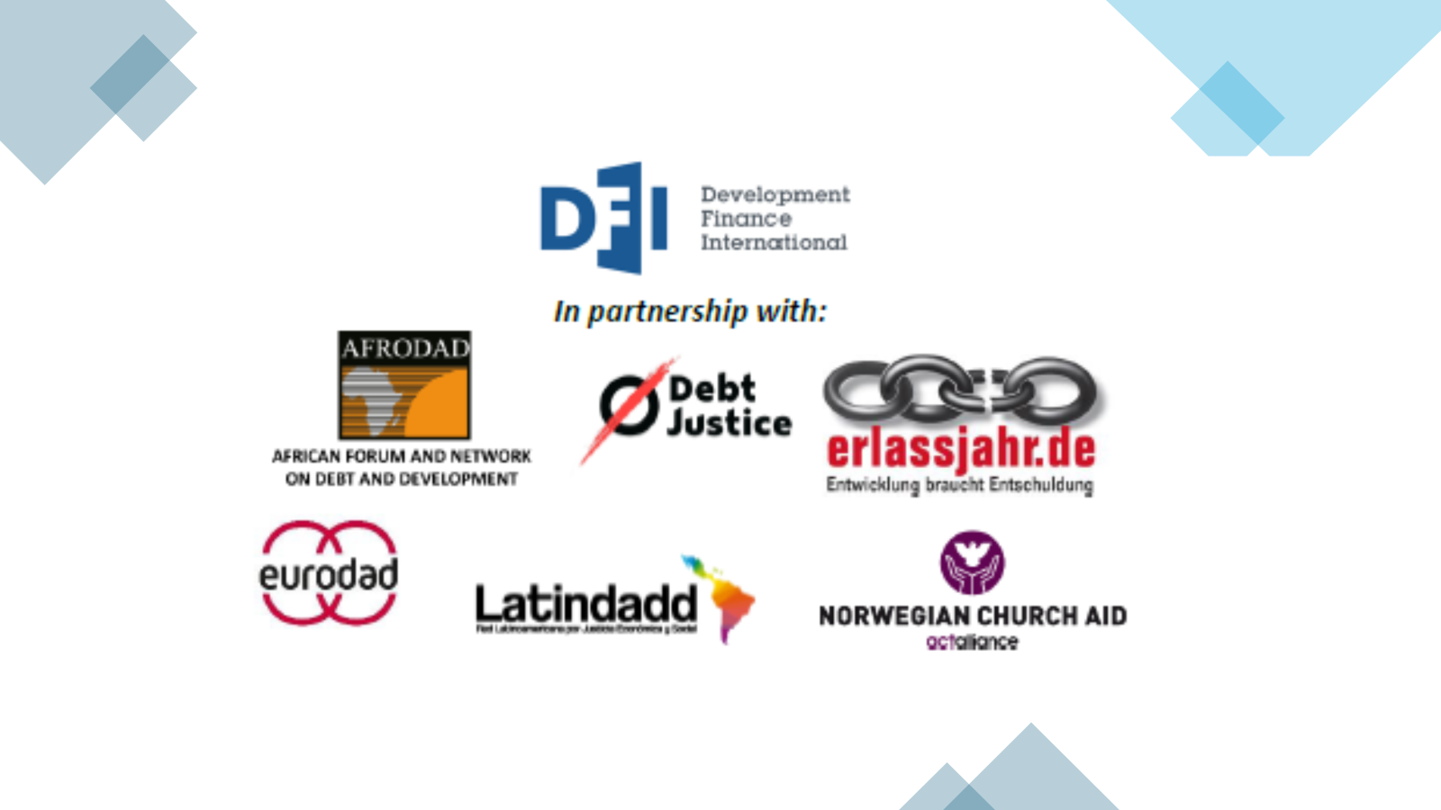

Slide 32
92 countries exceed a threshold of 15%, and 74 countries a threshold of 20%. A further 5 countries would have high ratios but are in default on most of their debt

Slide 33
Insufficient Debt Retructuriing
The countries have to cut their government spending by a cumulative 4% of GDP over the next 5 years. While efforts may be made to protect some social spending by setting “floors” within this reduced total, it is not obvious that this will succeed based on recent experience6. Even if it does, it is obvious that the deals will provide no scope for a major increase in spending to accelerate progress on the SDGs.
This failure is because no clear target for debt service/revenue is being set to judge whether debt relief deals leave countries with sustainable debt levels, especially in the short-to-medium-term, and therefore debt service/revenue is being reduced to 15-20% over only about 10 years. In turn, this reflects the reluctance by creditors to provide the same scale of relief as was provided in earlier debt crises.
In contrast, under the HIPC Initiative, even before the extra MDRI relief was introduced in 2005, creditors worked towards a broad target of bringing debt service below 15-20% of budget revenue, and the ultimate outcomes of the HIPC and MDRI deals reduced debt service to an average of only 11% of revenue7. The same scale of effort by creditors is needed now to save the Sustainable Development Goals, and debt relief agreements should set and meet explicit debt service/revenue targets beginning in the year of relief.

Slide 35
Debt Restructuring Framework
1. No principal payments to creditors that do not provide refinancing
2. Interest rate reductions through debt operations
Requires private sector participation in debt operations
3. Change the structure of incentives: reduction of 9% compensatory pre-judgement rate under NY law plus reenactment of champerty
4. Revert exposure of LLMICs to the international private sector (MDB guarantees as the vehicle)
5. New interest rates on bonds close to WB rate
6. Any IFI financing should be used for countercyclical or growth policies, no for debt amortizations
7. Debtor countries should develop their DSAs independent of the IMF to negotiate with the IMF.

Slide 37
Reform IMF interest rate and charges
IMF lending rate = 100bp (margin set by the IMF Board of directors) +
SDR rate +/- burden sharing + Surcharges

Slide 38
Debt Jubilees
The Year of Jubilee, 2025
2500 BC – 1600 BC in Babylonian times.
Normal for new rulers t proclaim amneties
Upon taking the throne
In the aftermath of war
Upon building or renovating a temple
3 elements
Cancel agrarian debts owed by citizens
Liberate debt bond servants
Return the land or crop rights that debtors had pledged to creditors
  Not “silver” debts among traders and entrepreneurs
  Michael Hudson --- and Forgive them their Debts, Dresden 2018
MDRI, HIPC and Jubilee 2000

