Slide 1
Global macropolicy in a world of volatile capital flows

Slide 2
What is macroeconomics?
Normal response: The branch which deals with the big questions—what determines national output, inflation, and unemployment.
Macro policy refers to the measures seen as instruments to influence these variables.
Broadly two sets: (a) fiscal policy measures; and (b) monetary policy measures.
Do we need a separate “macroeconomics”?

Slide 3
Mainstream view
Price taking individuals maximise utility subject to budget constraints. That determines how much they work, the commodities they demand and their saving.
Firms are rational agents minimising costs and maximising profits given resources and prices. This determines what each firm demands and supplies.

Slide 4
The macroeconomic outcome
Aggregate demand and supply are determined by adding up these individual demands and supplies.
If there is excess demand in any market, prices rise, leading to fall in demand and rise in supply, which equates the two. If there is excess supply, prices would fall.
This continues till the system reaches an equilibrium at which all markets clear.

Slide 5
Implication
In equilibrium, all markets clear with no excess demand or supply.
No real analytical distinction between macro and micro.
No role for unemployment since the system would generate full employment through price (wage) adjustment.

Slide 6
‘Actual’ market economies
Experience (starkly, the Great Depression) showed that in ‘actual’ market economies even if agents behave “rationally” there is no reason why markets would clear, especially the labour market.
The economy can settle temporarily in a position which people want to move out of, because many are unemployed ‘involuntarily’.

Slide 7
Origins of modern macroeconomics
So, the world imagined in neoclassical microeconomics does not provide the foundations of macro.
“Macroeconomics” emerged in the 1930s as a separate field largely in response to the Great Depression. In the US, for example, unemployment rose to 25 per cent.
Challenge was to explain why the market left to itself was not ensuring full employment and recommend policies to deal with it.

Slide 8
Keynes’ General Theory
Keynes, showed why in actual market economies, unemployment would be the norm, since aggregate demand tends to be inadequate to employ the labour force in full.
Governments must intervene to generate the demand required for full employment with public expenditure. Fiscal policy is the stabiliser.
This was already being demonstrated with policies adopted by Franklin Roosevelt who assumed power as President of the US in 1933.The results were stark. When FDR assumed office in early 1933, the U.S. unemployment rate was 24.8%. In 1941, before the U.S. war effort began in earnest, unemployment stood at 9.9%.

Slide 9
The Keynesian era (1945-1970)
Period when Keynesian-style demand management was common.
Fiscal activism: Taxation, borrowing and government spending
Welfare state and the automatic stabiliser
Golden Age: Creditable growth, near full employment, and low inflation.

Slide 10
Inflation and the decline of Keynesian
The fundamental factor that resulted in the retreat of Keynesiaism and the rise of “monetarism” was the inherent inability of capitalism to sustain a system with low unemployment and low inflation.
Inflation reared its head in the 1970s
This proved disruptive and provided an opportunity for the rise of modes of thought that opposed government intervention on the grounds that it led to inflation.

Slide 11
The new macro
Rely on monetary rather than fiscal policy, which was inflationary.
Monetary policy instruments—interest rate changes and money supply adjustments—were the best tools for stability.
Target is not full-employment, since the theory assumes that if prices (and wages) are flexible, full employment would be the norm.
Target of policy now “inflation”, and when inflation is low, “growth”.

Slide 12
Macropolicy at the global level
All nations have explicitly or implicitly adopt macropolicies.
But with economic integration policies such as interest rate adjustments in the developed countries affect capital movements or the cost of foreign exchange for the less developed, especially after the 1980s.
Increasingly, governments lack the freedom to adopt macroeconomic policies best suited to them.

Slide 13
Changes over time
Capitalism always a global system: combined pillage and plunder with predatory trade and investment to extract raw materials, prise open markets and transfer surpluses to the metropolis from the periphery.
But it was only by the early 1980s that technological change created the basis for the truly international firm. Triggered relocation.
Simultaneously changes in the financial system in the developed countries, led to financial globalization

Slide 14
Implications of colonialism
Underdeveloped countries forced by political subordination to opt for open economic regimes.
Economic performance directly related to the performance of the world economy.
Developed countries producers and exporters of modern manufactures and developing countries of primary commodities.
Adverse terms of trade effects

Slide 15
After World War II: The Golden Age
Decolonisation and the emergence of independent national states
Enforced diffusion of manufacturing to developing countries pursuing import substituting industrialization strategies.
But diversification limited in most UDCs.

Slide 16
Post-1970s inflation: Globalization
Acceleration of global integration.
From the point of view of economics, three principal elements: integration through trade, internationalization of production and globalization of finance.
Trade liberalization accompanied by export-led industrialization in some countries.

Slide 17
The diffusion of manufacturing
Mobility of capital-in-production, to take advantage of low wages. From enforced to spontaneous diffusion
But evidence shows this wasn’t generalized
Moreover, it did not end the maldistribution of global output gains. Wage rates remain low in the metropolitan centres and the periphery.
Rise in the share of surplus globally resulting “underconsumption”

Slide 18
Post WTO: Average global tariffs, 1995-2014 (%)

Slide 19
Developing countries’ trade in manufactures

Slide 20
Global industrial workforce

Slide 22
Global wage share, 1995-2014 (% of global income)

Slide 23
The “Smiley Curve”
Wages, value, and price formation along the Global Production Chain

Slide 24
Trade and finance
Trade liberalization has been coterminous with the rise to dominance of finance.
Liberalization of trade and of the rules governing the cross-border flows of capital result in a widening of the trade and current account deficits of the liberalizing economy.
Access to foreign capital to finance that deficit is a prerequisite for “successful” liberalization.
Neoliberalism and financial globalization feed on each other. Financial opening transforms the nature of state intervention.

Slide 26
Capital Mobility in Modern History

Slide 27
The Burgeoning of Finance since the 1990s
Oil surpluses held as deposits with the international banking system necessitating lending to and investing in LDCs
Expenditure fuelled by credit increased energy demand and surpluses
By 1981, OPEC surpluses totalled $475 billion, $400 bn parked in the developed industrial nations

Slide 28
Dollar’s role as reserve currency
No national budget constraint on US
US built up large international liabilities, with the trend accelerating after 1960s: loss of competitiveness and expenditures on the Vietnam War and policing.
Explosion of the Eurodollar market in the 1970s.

Slide 29
A new factor
Triggered flows of yield seeking financial capital from the DCs to LDCS.
Since the global financial crisis, this flow has turned into a veritable ‘push’ of capital from the North to the South, because of the infusion of cheap liquidity following the rise to dominance of monetary policy and the adoption of “easy money” policies.

Slide 30
The shift in macropolicy
Countercyclical State policy on the decline.
Inflation of the 1970s led to the “Volcker Shock” in which monetary policy was “demonstrated” to be successful.
Reliance on interest rate adjustment to respond to inflation and recession, and cheap liquidity infusion to drive credit-fuelled growth and address ”crises”

Slide 31
The neoliberal myth
Returning power to markets an excuse to bolster finance.
The banking crisis of the 1930s led to stringent financial regulation. This did not hamper the Golden Age.
Yet after the stagflationary crisis of the 1980s, unfettering finance was presented as crucial for capitalist dynamism.
Led to the financial instability and the crisis of 2008.

Slide 32
The response of the state
Mainly based on monetary policy adjustments
Fiscal stimulus unavoidable but was deployed late and only for a limited time.
Far greater reliance on monetary policy: quantitative easing and low interest rates.
Quantitative easing involved large scale bond buying at par by the Fed only partly to inject liquidity into the system. Prime intent was to take worthless assets off the balance sheets of the banks.
Interest rates brought down to near zero to help them return to profitability.

Slide 33
Fiscal stimulus

Slide 34
Liquidity injection

Slide 35
Low interest rates

Slide 36
Consequences
With demand still depressed but cheap capital in abundance, capital flowed into asset markets.
Triggered the “carry trade”: borrow cheap in dollars and invest in markets abroad
Large flows of capital to LMICs.

Slide 37
International Lending Boom
Relative to world output, net international bank loans rose from 0.7 per cent in 1964 to 8.0 per cent in 1980 and 16.3 per cent in 1991. Relative to world trade, from 7.5 to 42.6 and 104.6 per cent
In the early 1980s the volume of transactions of bonds and securities between domestic and foreign residents accounted for about 10 per cent of GDP in the US, Germany and Japan. By 1993 the figure had risen to 135 per cent for the US, 170 per cent for Germany and 80 per cent for Japan.

Slide 38
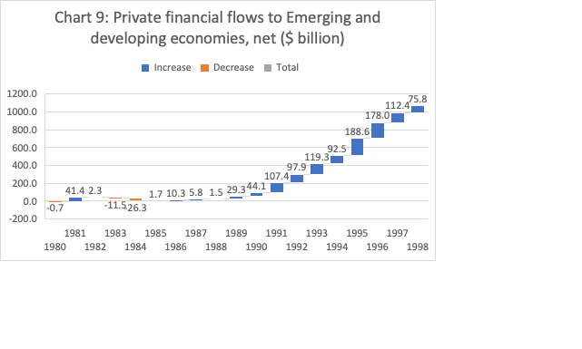
Capital flows to EMDEs: 1980-1998

Slide 39
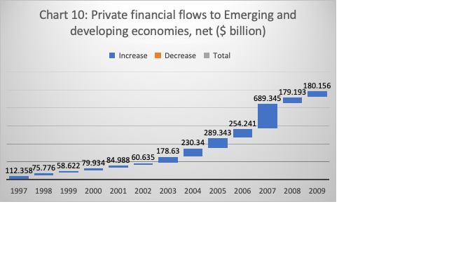
Capital flows to EMDEs: 1997-2009

Slide 40
A new phase in debt
As a result of this supply-side push of capital, over the decade and a half following the crisis, most low- and middle-income countries were encouraged to take on more loans, particularly from bond investors interested in more risky debt.
This was looked upon benignly by the IMF as a sign of greater integration (and possible convergence).
Actually it was a way of “managing” external stress following trade liberalization.

Slide 41
The surge
The total outstanding debt of Emerging Market and Developing Economies rose from $2.4 trillion in 2001 to $8.9 trillion in 2014. After a year’s gap it spiked again to $11.9 trillion in 2021.
Excluding China, the total external debt of EMDEs rose from $4.8 trillion in 2009 (after the global financial crisis) to $8.9 trillion in 2020. Excluding all five BRICS countries, the corresponding figures were $3.8 trillion and $7.2 trillion.

Slide 42
An era of debt and financial crises
late 1970s
Crisis in the Southern Cone in the late 1970s
early 1980s
Third World debt crisis of the early 1980s
late 1980s
The savings and loan debacle in the US in the late 1980s
1992
The ERM crisis in 1992 that led to the withdrawal of Britain from the European Exchange Rate Mechanism
1994–1995
The Mexican crisis of 1994-95 and its follow-on crisis in Latin America
1997
The East Asian crisis of 1997
1998
The Russian meltdown of 1998
1999
The collapse of the real in Brazil in 1999 and its impact on the rest of Latin America
2000
The dot com bust of 2000 (Nasdaq rises five fold from 1995 to 2000 and then falls from 5049 on March 10, 2000 to 1140 on Oct 4, 2002).
2008
The GFC of 2008-09.

Slide 43
Anti-inflationary policy worsens debt stress
Soaring inflation saddled developing countries with a record $1.4 trillion in debt servicing costs in 2023, according to the World Bank.
As central banks around the world raised interest rates to slow rising prices, poor countries with already high debt burdens saw the interest payments on the money that they owed to creditors balloon.
While principal balances held steady at around $951 billion, interest payments jumped by a third, to $406 billion.

Slide 44
High risk premia
The interest cost on external borrowing is on average three times more for developing countries than for developed countries, according to Brookings.
Developed countries have borrowed at interest rates around 1% while the least developed countries have borrowed at rates ranging from 5 to 8%.

Slide 45
The interest burden
LDCs borrow only half as much as a share of GDP as developed countries but spend three times more on interest repayments.
Up to 34 developing countries’ debt-servicing obligations are estimated to exceed 15% of revenue.
For more than half of the countries in Sub-Saharan Africa, debt servicing swallows up more than a quarter of all government revenue.

Slide 46
The problem of debt sustainability
According to the IMF, as of 2023, about 15 per cent of low-income countries were in debt distress and an additional 45 per cent were at high risk of debt distress. A significant share of this debt was foreign currency debt.
Restoring the capacity to service accumulated debt seen as the dominant challenge.

Slide 47
IMF and the crisis
The IMF enters the picture when the crisis in an afflicted country has reached a point when foreign exchange reserves have collapsed, supplies of imported essentials are scarce, recession and inflation are severe.
Obtaining some emergency external financing becomes imperative even to stabilise economies, making countries desperate for such support.
In such ‘bail outs’, the IMF’s financial contribution to the resolution effort is a fraction of the required financing. Yet staff level approval for support becomes dependent on the government adopting IMF-style adjustment measures that impose new burdens on an already-devastated population.

Slide 48
Turn to austerity
Recommends multiple measures aimed at contracting the system, ostensibly to reduce imports and release exportable surpluses, with devaluation, expenditure reduction and regressive taxes.
The focus of these restructuring programmes is to curtail budgetary expenditures (especially on capital and social spending).
Proactive fiscal policy discouraged.

Slide 49
Requirements of global finance
Nature of state intervention needs to be modified
Proactive intervention that legitimizes the state and delegitimizes capital needs to be withdrawn.
State must be used to open up areas that were sealed off to finance during the Golden Age and during the Age of Decolonisation
State must be used to offer tax concessions, mineral rights, etc to capital. Privatization a consequence.
The Great Redistribution, which worsens the realization crisis.

Slide 50
Consequences for Global Growth

Slide 51
1980-22 Gr vs 1980 income: richer countries have grown faster

Slide 52
Distribution of Annual per capital growth rates

Slide 53
Winners and losers

Slide 54
Structural changes
Cross-border deals involving financial institutions from EMEs as targets, which accounted for 18% of such M&A deals worldwide during 1990-96, rose to 30% during 1997-2000.
The value of financial sector FDI rose from about $6 billion during 1990-96 to $50 billion during the next four years. Such FDI peaked at $20 billion in 2001, declined sharply in 2002, but stabilized in 2003. The net result is a clear shift in the ownership structure of the financial sector

Slide 56
Consider for example Mexico
At the end of 1996 prior to new rules regarding foreign ownership, only 7 percent of total bank assets were controlled by foreign banks.
By March 1997, 14 percent of bank assets in Mexico were controlled by foreign banks. By December 2002, the share of Mexican banks under foreign control increased to 66 percent.
By the 2000s around 19 of Mexico’s 32 banks were foreign owned. These include the three largest banks in the system: Bancomer (owned by Banco Bilbao Vizcaya), Banamex (owned by Citibank), and Banca Serfin (owned by HSBC).
The banks not under foreign ownership are extremely small.

Slide 57
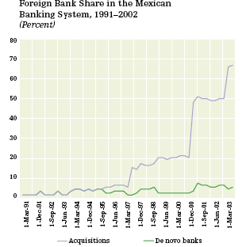
The foreign invasion: Control over national savings

