Slide 1
Growth, Employment and Inequality in Contemporary Chinese Development
Andong Zhu
2024.12.14 Bankok

Slide 2
Outline
1. The economic development of contemporary China
2. The Challenges and Opportunities of China’s economic development
3. Possible future development
Notes:
The Challenges and Opportunities of China’s economic development
Challenges
Social tension
Corruption
Pollution
Unsustainability of the old Economic growth pattern
Stag-bubble of the US economy and the deepening of the systematic crisis of the world economy
Opportunities
Stable society
huge market
excellent Infrastructure
Industry Clustering
Outstanding Education System
Huge R&D Investment and rapid technological development
Some points of Xi Jinping Thought on Socialism with Chinese Characteristics for a New Era
Chinese Dream
Anti-corruption
new vision for development
Idea of people-centered
Possible future development

Slide 3
52.3 times Increase in GDP
Source: CSY
35.4 times Growth with per capita GDP

Slide 4
Huge Amount of Foreign Reserves
Source: www.safe.gov.cn

Slide 5
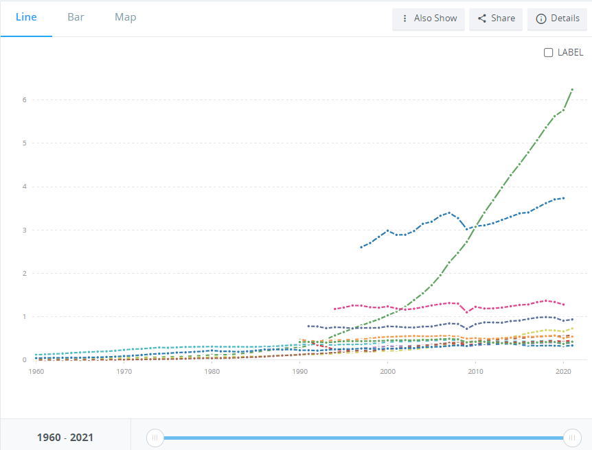
Value-added of Industry (2015 US$)
China
USA
Japan
Germany

Slide 6
Souce：UNIDO
Notes:
https://stat.unido.org/database/CIP%202019

Slide 7
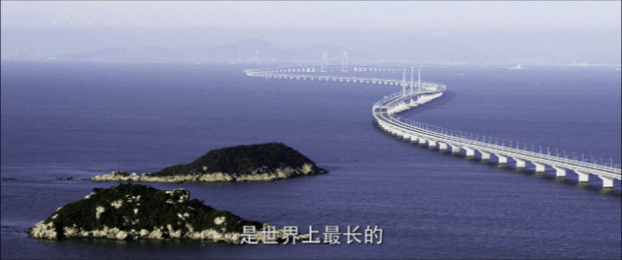
Hongkong-Zhuhai-Macao Bridge, 55KM

Slide 8
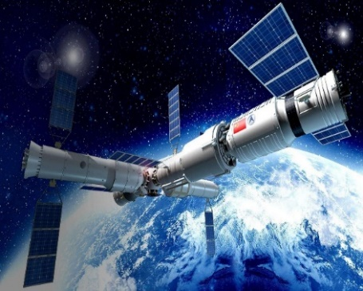

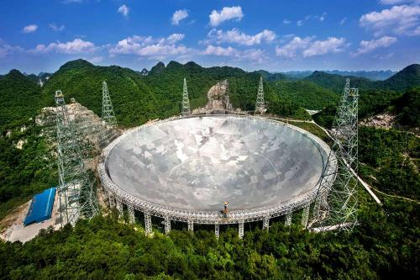
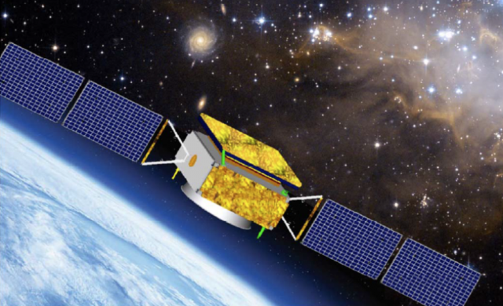
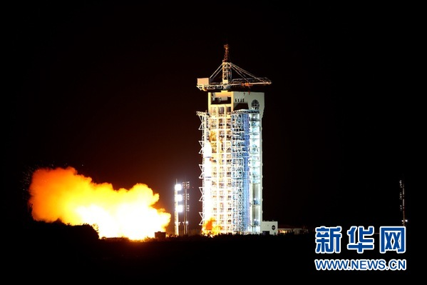
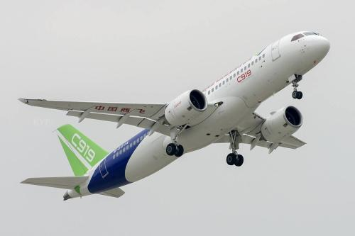
High-Tech Projections

Slide 9
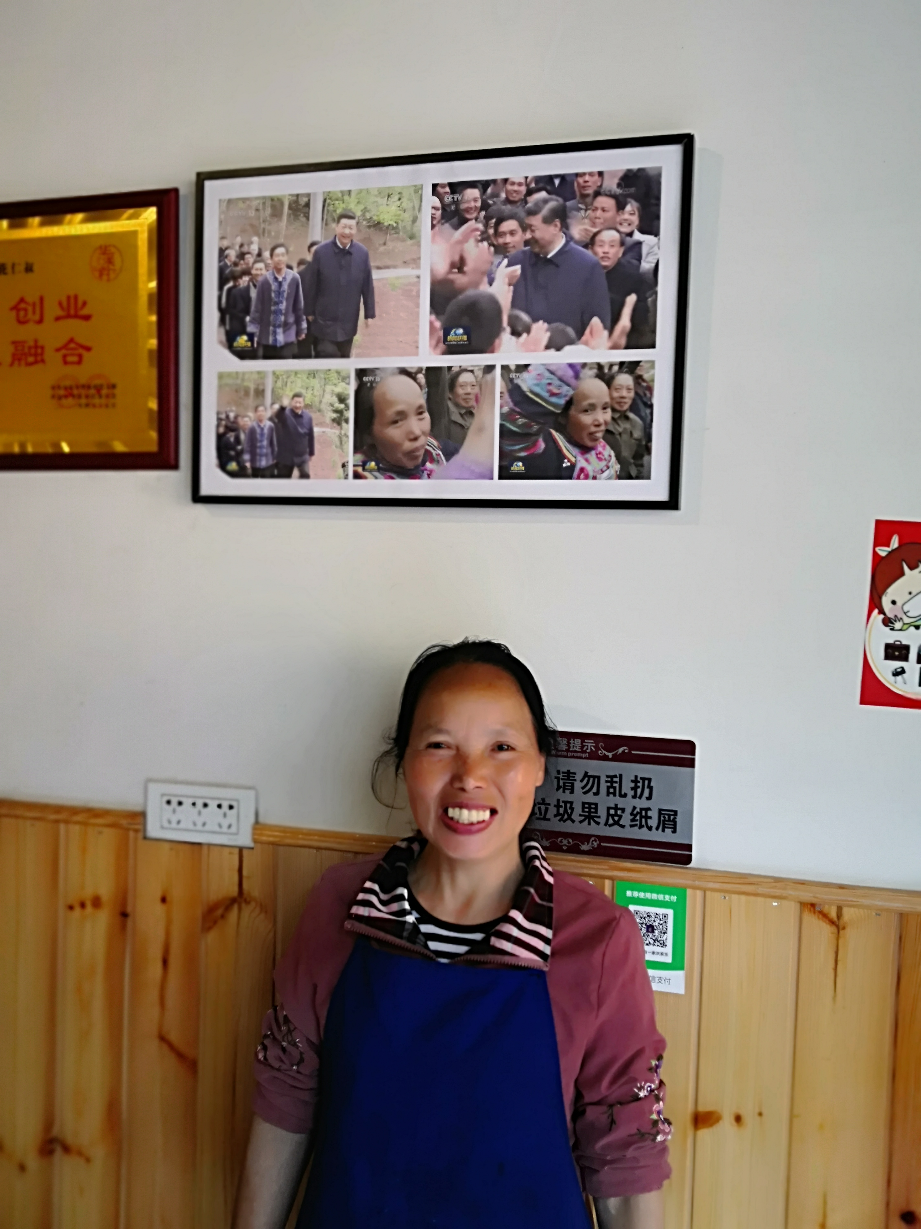

打赢了人类历史上规模最大的脱贫攻坚战
40年来，按照世界银行每人每天1.9美元的全球绝对贫困标准衡量，中国的贫困人口减少了近8亿，占同期全球减贫人数近75%。
2021年，居民人均预期寿命为78.2岁。
1980年，居民人均预期寿命为68岁。
——中国财政部、国务院发展研究中心与世界银行联合发布《中国减贫四十年》研究报告
——国家卫生健康委员会《2021年我国卫生健康事业发展统计公报》

Slide 10
Challengs
Economic slowdown
Employment: quantity and quality
Inequality
Systematic crisis in the world capitalist economy

Slide 11
5 year moving average of China’s GDP growth rate

Slide 12
CPI
  Since 2023, the year-to-year growth rate of CPI has continuously declined from 2.1% in January to -0.2% and -0.5% in October and November respectively; the month-on-month growth rate of CPI has also been negative in October and November, with the decline increasing.
  Since 2023, the core CPI has been in a low growth range of (0, 1%) year-on-year; the month-on-month growth rate of core CPI was 0 in October and -0.3% in November.CPI is a thermometer that measures the level of activity in the consumption sector, reflecting the supply-demand relationship in this sector. A continuous decline in CPI indicates insufficient current consumer demand.
图表 CPI同比和环比增速 图表 核心CPI同比和环比增速
数据来源：国家统计局 数据来源：国家统计局

Slide 13
PPI
Since October 2022, the year-to-year growth rate of PPI and PPI means of production has been negative for 14 consecutive months. Since May 2023, the year-on-year growth rate of PPI consumer goods has also been negative continuously, and the decline is continuing to expand. I
n the past 12 months, the month-on-month growth rates of PPI, PPI means of production, and PPI means of production have experienced intermittent negative growth for 7 months, 7 months, and 8 months respectively.
PPI reflects the supply and demand relationship in the production process. The continuous sluggishness of PPI largely reflects the relatively insufficient investment demand of current production enterprises.
图表 PPI、PPI生产资料、PPI生活资料同比增速 图表 PPI、PPI生产资料、PPI生活资料环比增速
数据来源：国家统计局 数据来源：国家统计局

Slide 14
Confidence Index
  2022年4月以来，衡量消费者景气程度的预期、满意、信心指数，持续处于低于100的低位，说明居民消费意愿不足。
  2022年初以来，企业景气指数持续下跌，明显低于疫情前两年（2018-2019）的120-130水平，说明当前企业的投资意愿不足。
图表 中国消费者景气指数 图表 中国企业景气指数
数据来源：国家统计局
数据来源：国家统计局

Slide 15
Real Estate Market
The current real estate market situation is very severe.
The apartment available for sale stands at 650 million square meters, which is at a historical high. Sales area has decreased by 40%, equivalent to the sales level of 2009. The area of new construction has dropped by more than 50%, equivalent to the construction level of 2008.
The balance of mortgage loans experienced a historically negative growth in the 3rd quarter.
70个大中城市新建商品住宅价格指数同比变化（%）
100个大中城市土地成交面积同比变化（%）

Slide 16
Employment
  From January to November 2023, the national urban surveyed unemployment rate averaged at 5.2%; in June 2023, the urban surveyed unemployment rate for those aged 16-24 reached 21.3%.
  The economy's capacity to absorb employment is showing signs of fatigue. For instance, ride-hailing and food delivery, as two major industries for employment absorption, have reached a state of saturation in 2023. The number of ride-hailing drivers nationwide quickly grew from 2.891 million at the end of 2020 to 5.09 million in December 2022, and to 6.334 million in October 2023. From January to October 2023, there was a net increase of 1.244 million drivers. Compared to January 2022, the monthly number of orders taken by ride-hailing drivers in October 2023 decreased from 176 to 128.
  In 2023, transportation departments in cities such as Shanghai, Chongqing, Guangzhou, Jinan, Zhuhai, and Dongguan have issued warnings of transportation capacity saturation, while cities like Sanya, Changsha, Shanghai, and Guiyang have suspended the acceptance of ride-hailing business licenses and the issuance of transportation permits. According to the "Ninth National Survey on the Status of the Employee Team" in 2023, the number of food delivery riders has reached 13 million, approaching a state of saturation. The number of Meituan delivery riders increased from 5.27 million in 2021 to 6.24 million in 2022, with an annual increase of 970,000.
图表 全国累计发放网约车驾驶员证（万本）
数据来源：交通运输部

Slide 17
Income Gini Coefficient in China: 1978-2023
贫富差距过大 High Income Inequality

Slide 18
Systematic Crisis of the World Capitalism
The ruling of the Financial Monopoly Catpical
Economic & Financial Crisis
Social Crisis
Cultural Crisis
Political Crisis

Slide 19
The process of production appears merely as an unavoidable intermediate link, as a necessary evil for the sake of money-making. All nations with a capitalist mode of production are therefore seized periodically by a feverish attempt to make money without the intervention of the process of production.
----Chapter 1, Vollume II, Das Capital

Slide 20
The Biggest Shareholders of the S&P500 Companies
 | 1 | 2 | 3 | 4 | 5
The Vanguard Group | 354 | 103 | 26 | 6 | 1
BlackRock, Inc. | 45 | 288 | 105 | 33 | 11

Slide 21
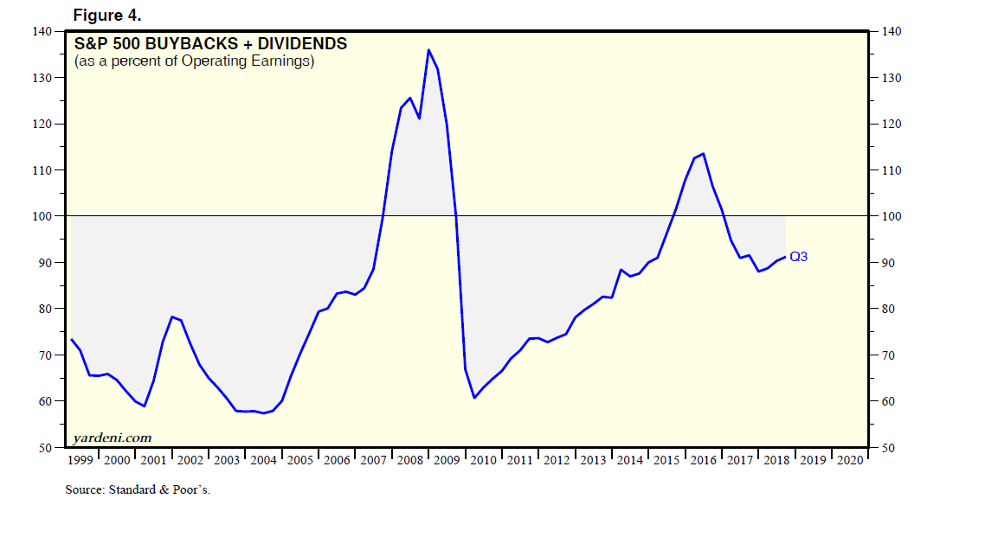

Slide 22
Value-added of Industry (2015 US$)
China
USA
Japan
Germany

Slide 23
Souce：UNIDO
Notes:
https://stat.unido.org/database/CIP%202019

Slide 24
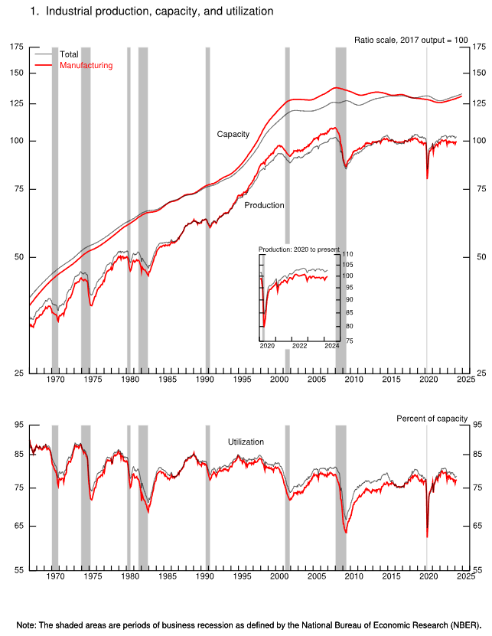
Re-Industrialization of the USA

Slide 25
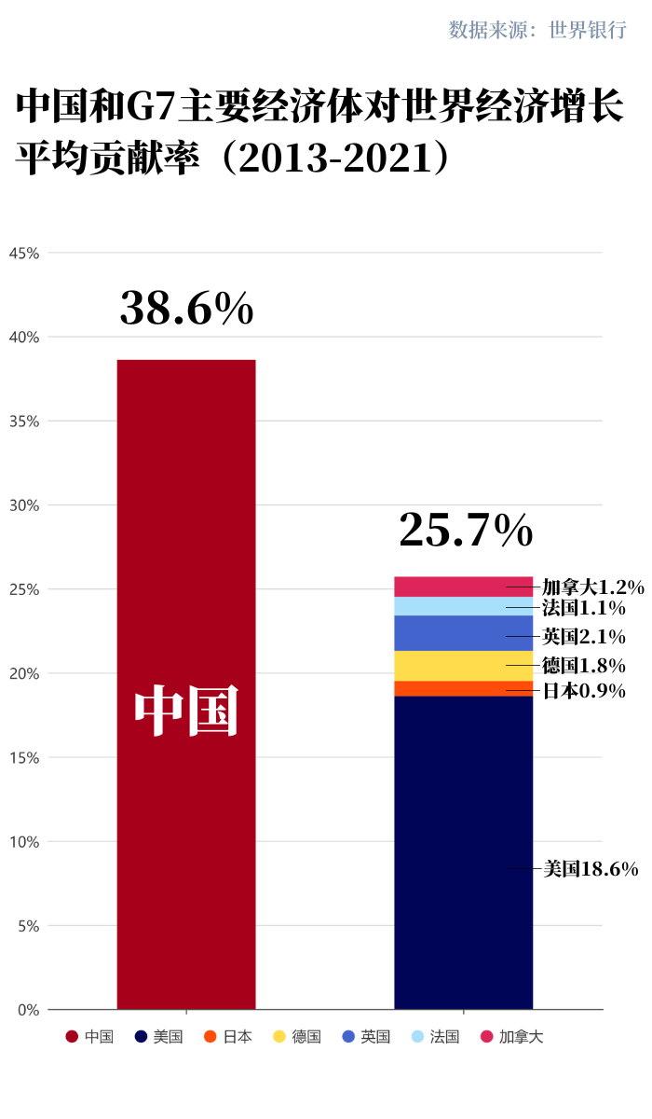

Slide 27
Real PE Ratio of S&P 500 Companies (1881.1~2022.4)
Source: website of Prof. Robert Shiller
Notes:
来自耶鲁大学的罗泊特．席勒教授

Slide 28
Public Debt of Advanced Economies(% GDP): 1880-2020
数据来源:国际货币基金组织《世界经济展望》（2021年4月）

Slide 29
Interest Payment and Defense expenditure of the US Federal Government (Bil.$):1947-2024

Slide 30
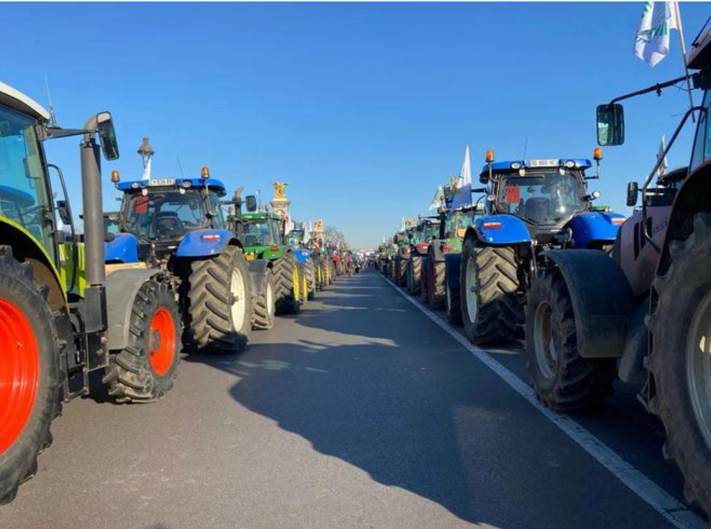
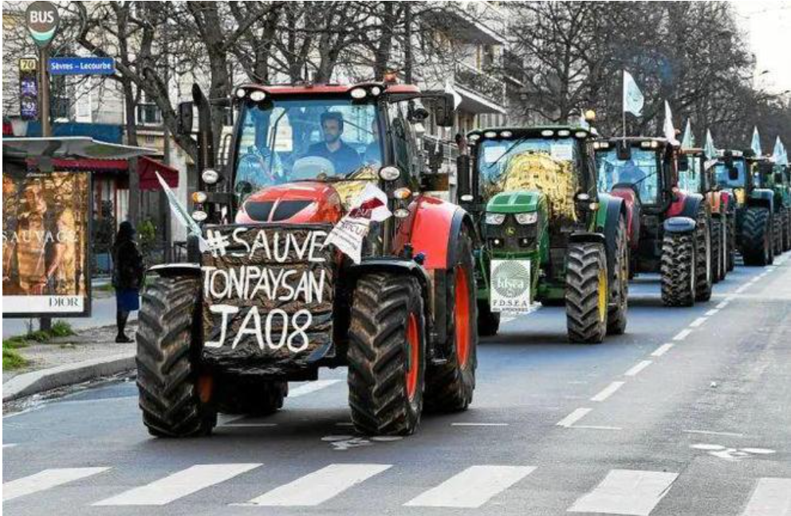
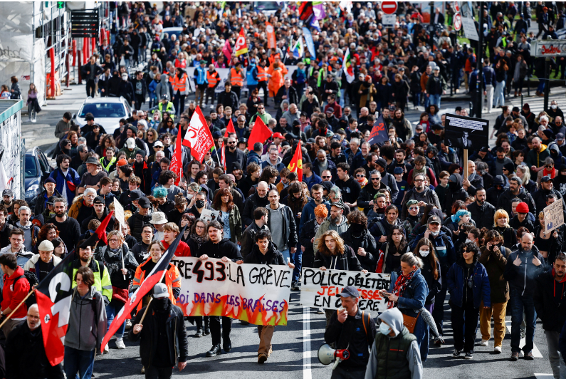
社会动荡

Slide 31
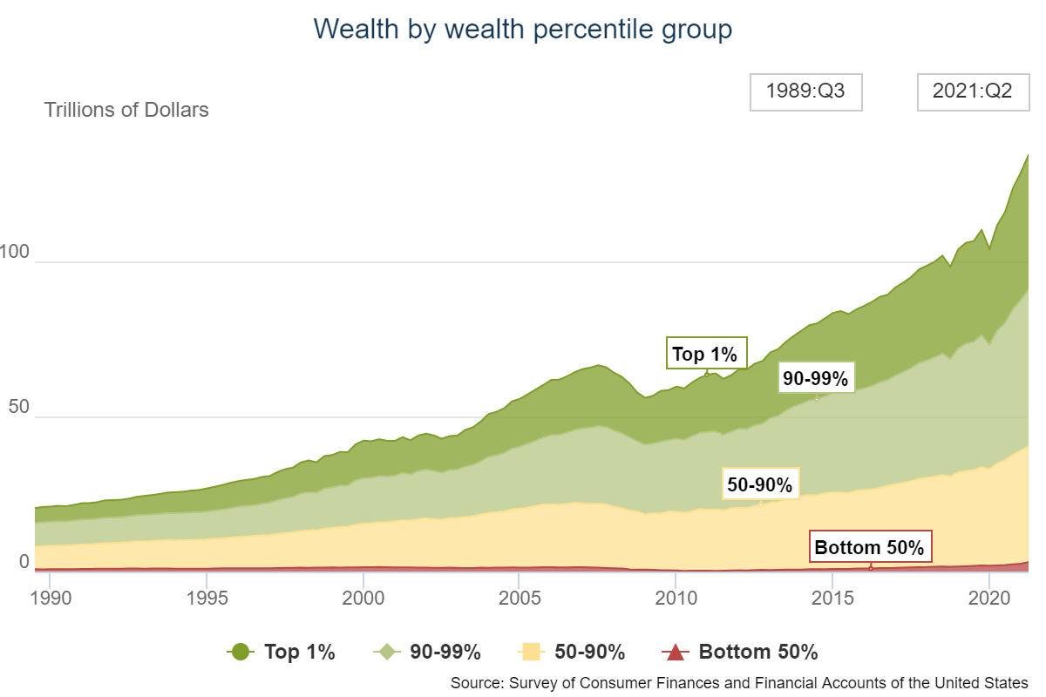
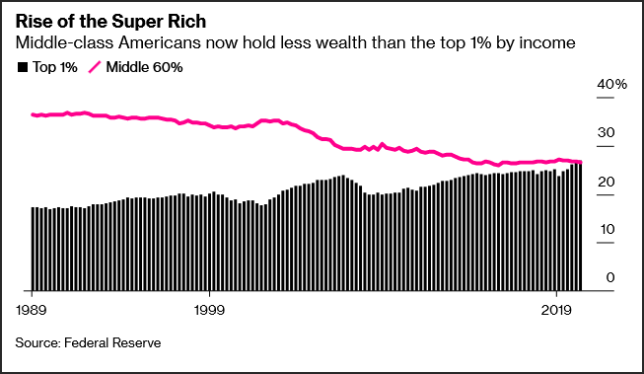
美国历史首次！前1%的超级富人拥有财富超过中产阶级总和
Notes:
据彭博社2021年10月9日报道，经济学家通常将“中产阶级”定义为收入在社会整体的中间60%的家庭。根据美联储本月最新统计数据，截至今年6月，美“中产阶级”在国家总财富中的占比已经跌至26.6%，创下过去30年来的新低。同时，前1%——即“超级富人”的财富高达社会总体的27%，首次超过整个中产阶级。

Slide 32
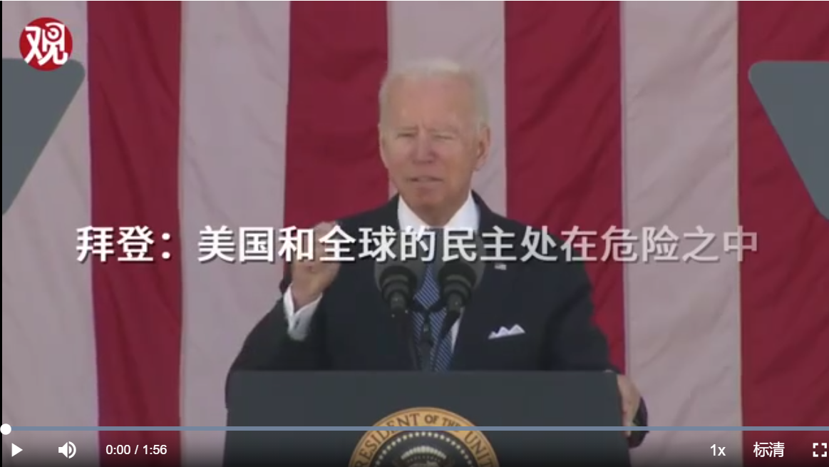
Political Crisis

Slide 33
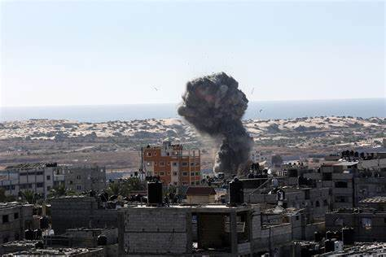
Isaril

Slide 34

Russia-Ukraine Conflict
The collapsing Yalta system or Westphalian System?

Slide 35
Cultural Crisis
The mainstream ideas, thoughts and theories can not explain what’s happening in the world, and can not propose effective policies to solve the problems.

Slide 36

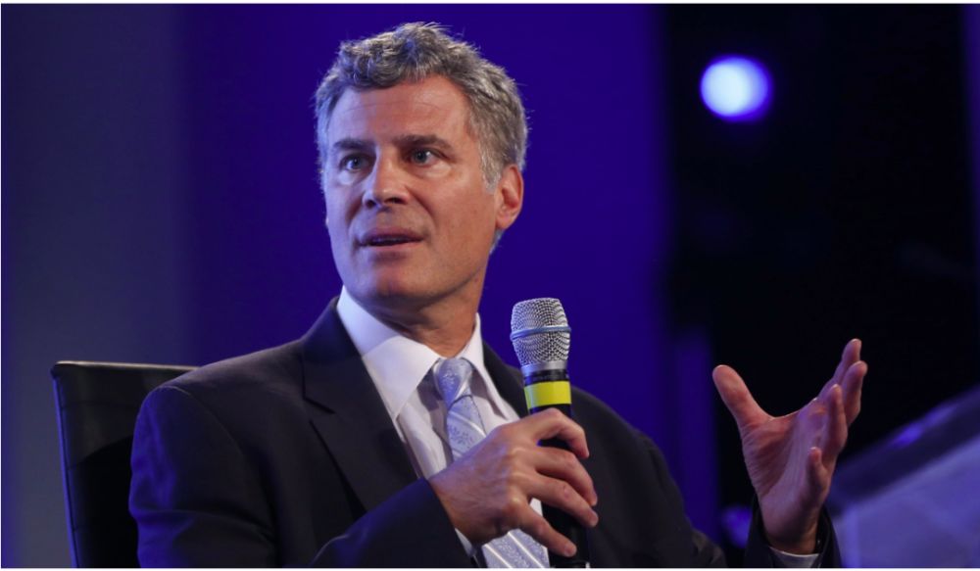


4 Famous Economists Committed Suicide Within 1 Year
Emmanuel Farhi
Alan Bennett Krueger
Martin Weitzman
William Sandholm
Notes:
7月23日，年仅41岁的哈佛大学经济学教授，曾经的法国“高考状元”Emmanuel Farhi（埃马纽埃尔·法希）意外身亡。
就在不到一个月前的7月6日，另一位年仅49岁的威斯康辛大学经济学教授William Sandholm（威廉·H·桑德霍尔姆，同事、朋友、亲人一般称他为Bill）亦自杀身亡。
另外两位辞世的经济学家分别是77岁的哈佛大学经济学教授Martin Weitzman（马丁·魏茨曼），他于2019年8月27日身亡；58岁的普林斯顿大学经济学教授Alan Bennett Krueger（艾伦·贝内特·克鲁格），他于2019年3月16日逝世。

Slide 37
A more chaotic and dangerous world
Neoliberalism
Right-Populism
Fascism

Slide 38
Major Challenges: ten years ago
社会矛盾 Social tension
腐败 Corruption
生态环境 Pollution
经济增长模式问题 Unsustainability of the old Economic growth pattern
世界经济挑战 Stag-bubble of the US economy and the deepening of the systematic crisis of the world economy

Slide 39
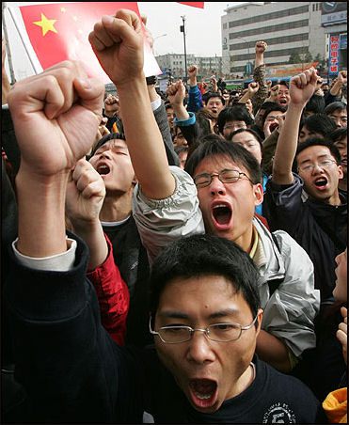
社会矛盾尖锐 Social Tension Rises
根据有关报道，我国群体性事件的数量从1993年的8700起上升到了2006年的9万起，2010年有12.7万起。
The number of reported "mass incidents" rose from 8,700 in 1993 to more than 90,000 in 2006, according to the Chinese Police Academy. According to the New York Times authorities recorded 127,000 so-called mass incidents in 2010
Notes:
http://factsanddetails.com/china.php?itemid=305&catid=8

Slide 40
贫富差距过大 High Income Inequality

Slide 41
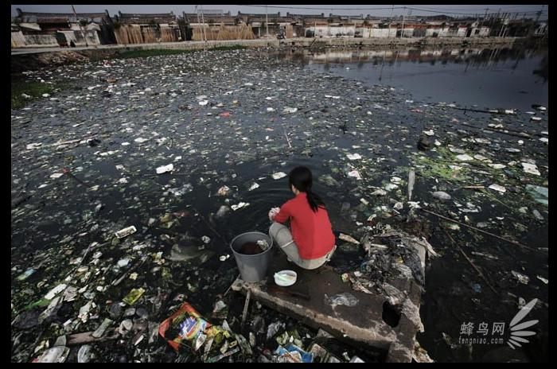
广东省汕头市潮阳区贵屿镇被称为「全球电子废料处理中心」,河流、水塘全被污染。
不但水质不适合人畜饮用,水面漂着大量垃圾,几乎密铺水面。
当地民众要在这个污染严重的水塘里洗涤。2005年11月25日
The Crisis between Human and the Nature：Pollution

Slide 42
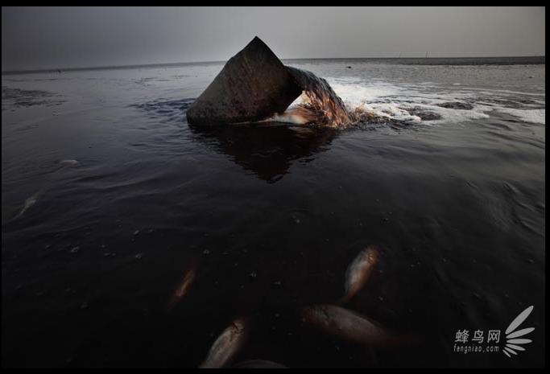
在黄海海岸线上,无数的污水管道埋在海滩上,甚至延伸进深海。2008年4月28日

Slide 43
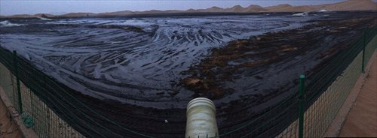
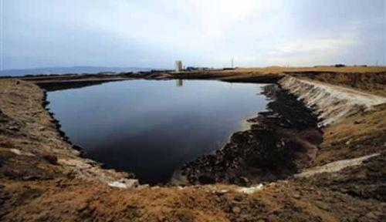
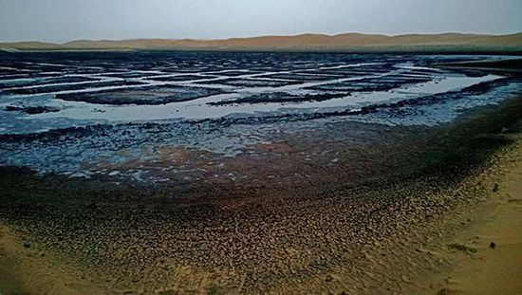
Tengger Desert pollution，2014

Slide 44
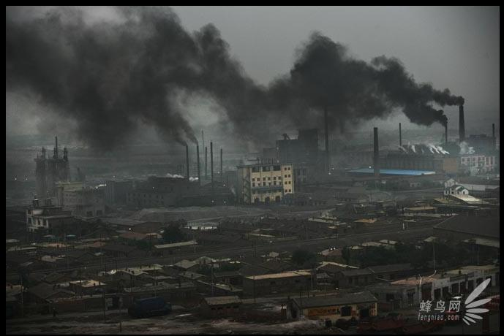
内蒙古拉僧庙发电厂二条黑色的巨龙,覆盖着村庄。2005年7月26日

Slide 45
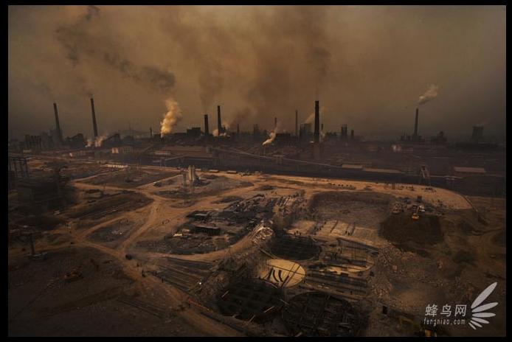
河北省涉县天津钢铁厂是重污染企业,企业规模还在不断扩大,
严重影响当地居民的生活。2008年3月18日

Slide 46
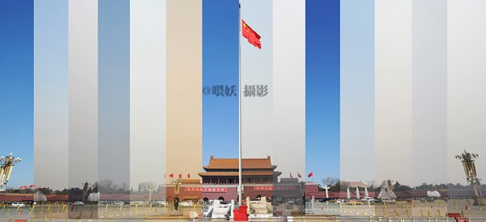
Beijing in 2013:3.4~17

Slide 47
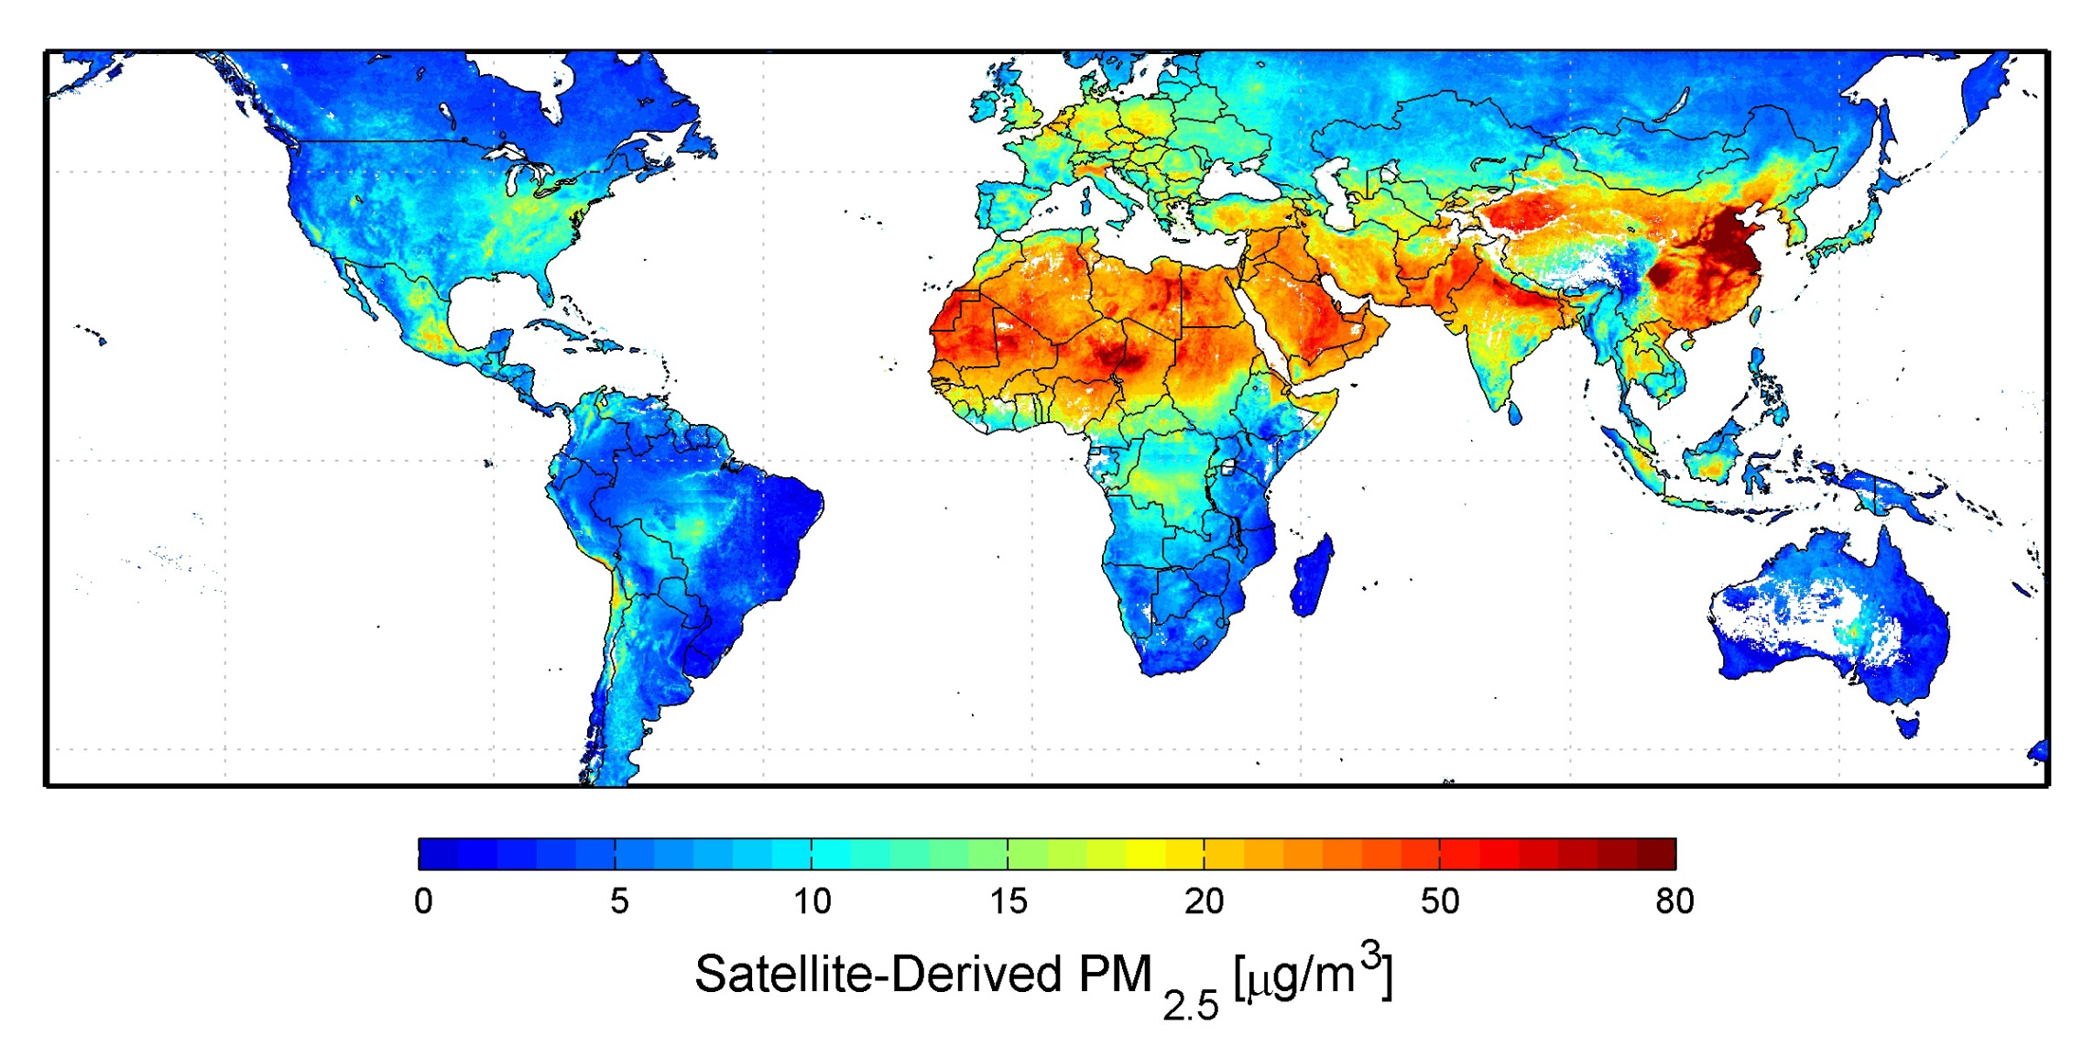
Global Air Pollution:2001-2006

Slide 48
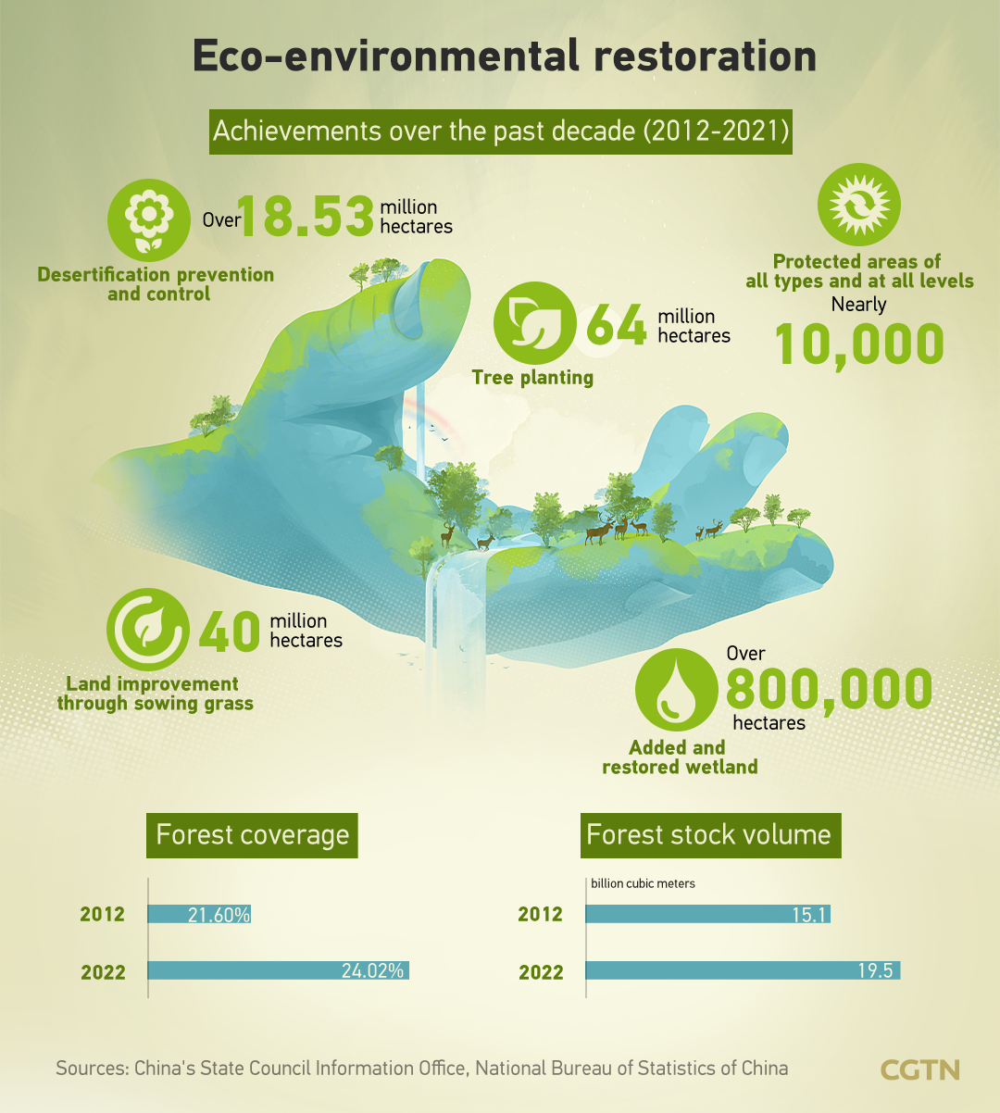

Slide 49
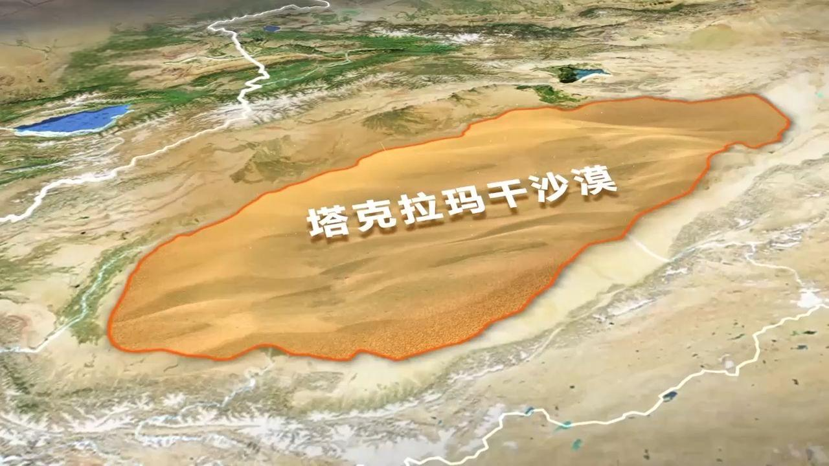
https://www.youtube.com/shorts/CBgzjN2pdfI?feature=share
<iframe width="349" height="620" src="https://www.youtube.com/embed/CBgzjN2pdfI" title="China&#39;s largest desert encircled by 40-year green barrier project" frameborder="0" allow="accelerometer; autoplay; clipboard-write; encrypted-media; gyroscope; picture-in-picture; web-share" referrerpolicy="strict-origin-when-cross-origin" allowfullscreen></iframe>

Slide 50
Contemporary Unsustainable Trends in China
Over-dependence on Investment
Over-dependence on International Trade
Low Consumption Ratio

Slide 51
Over-dependence on Investment
Source: CYS 2024

Slide 52
Over-dependency on International Trade
Source: WDI

Slide 53
China’s Consumption (% of GDP):1978-2023
Source: CYS

Slide 54
Income Gini Coefficient in China: 1978-2023
贫富差距过大 High Income Inequality

Slide 55
The Evolution of Growth Models in China

Slide 56
From Old China to New China
Old China
New China 1.0
New China 2.0
New China 3.0
Semi-Feudal
Semi-Colonial
Backward
Independent
Balanced
Economic
& Social
Construction
Market-Oriented
GDP Growth Fast
Income Inequality
Social Development
Environment
Sustainable
(Economic,
Social,
Environment)
Development
1949
1978
2012

Slide 57
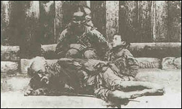
A Family in the “Old China”

Slide 58
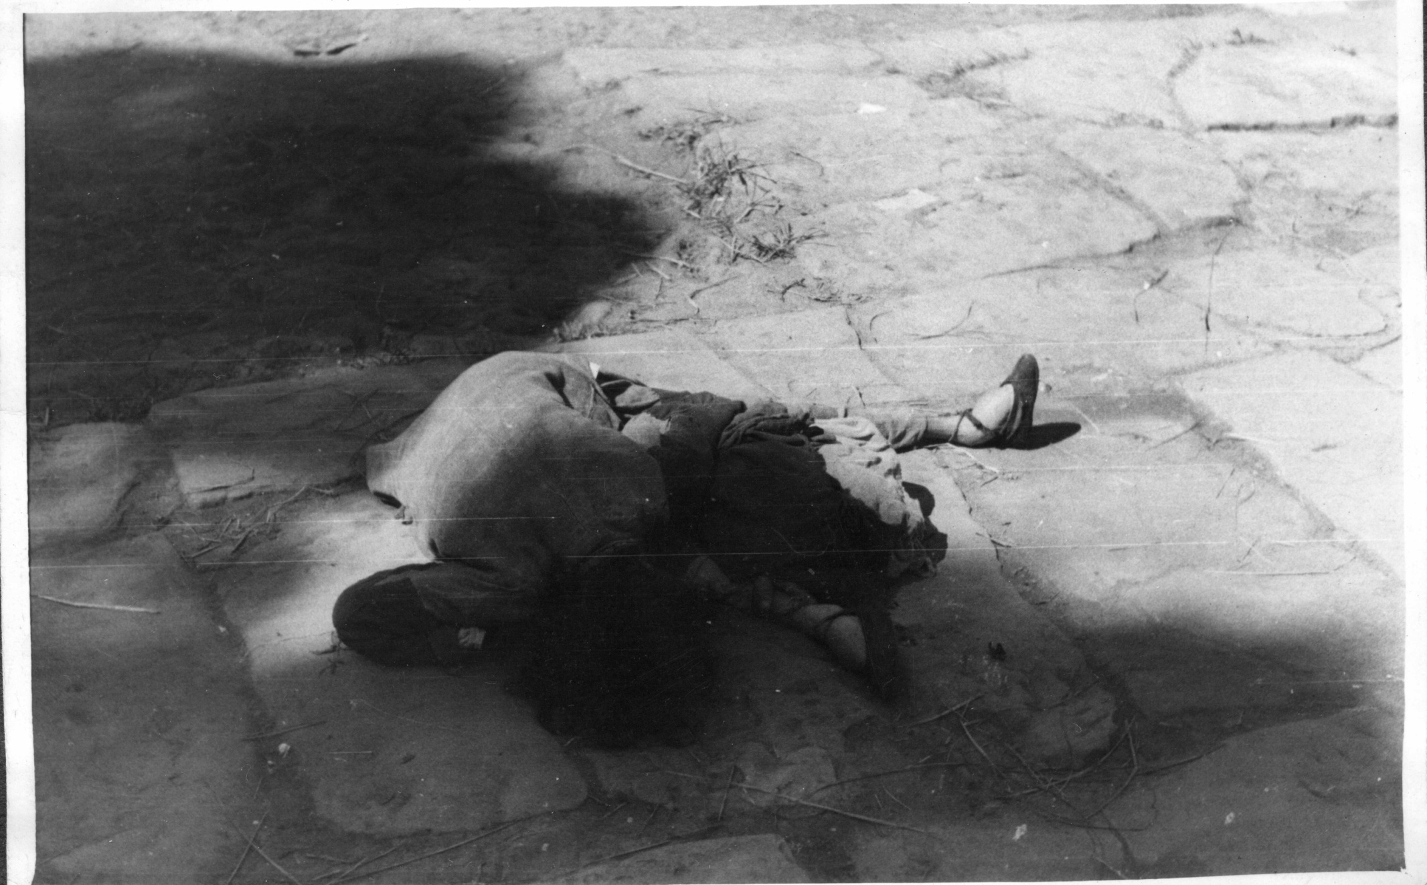
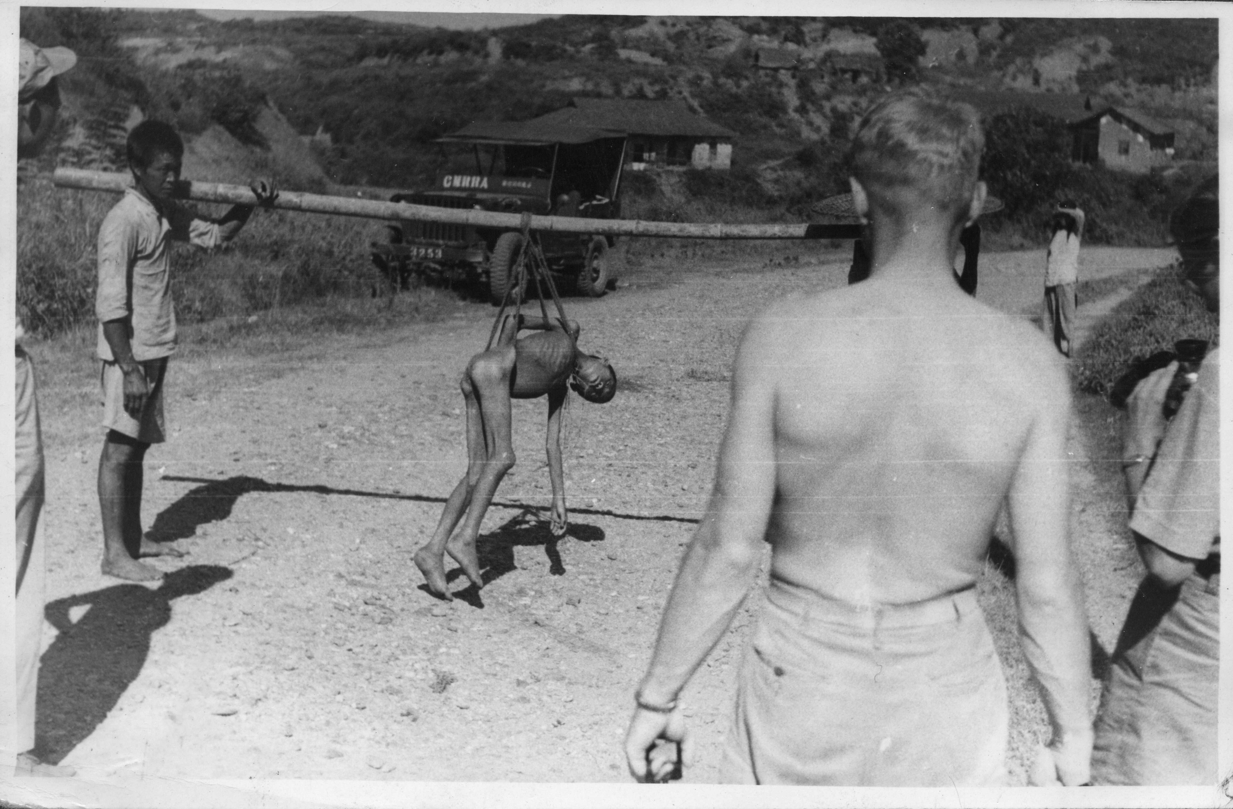
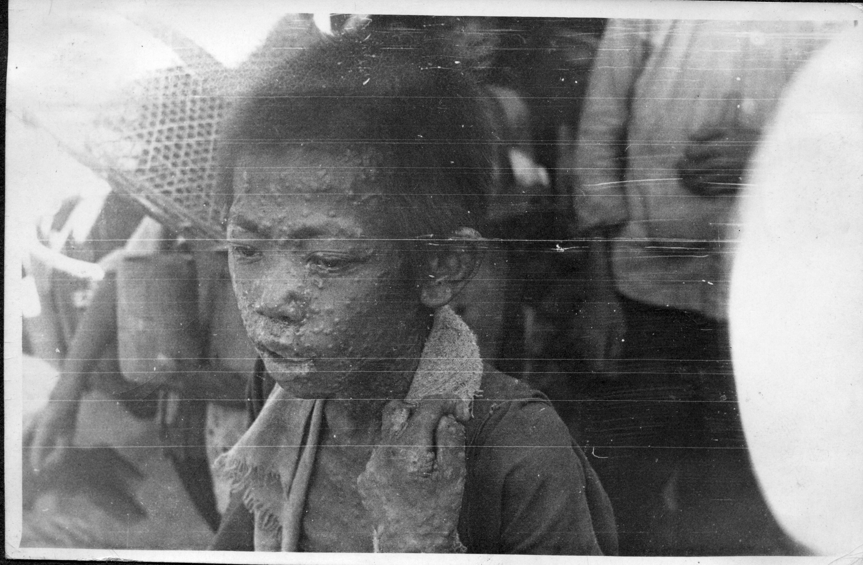
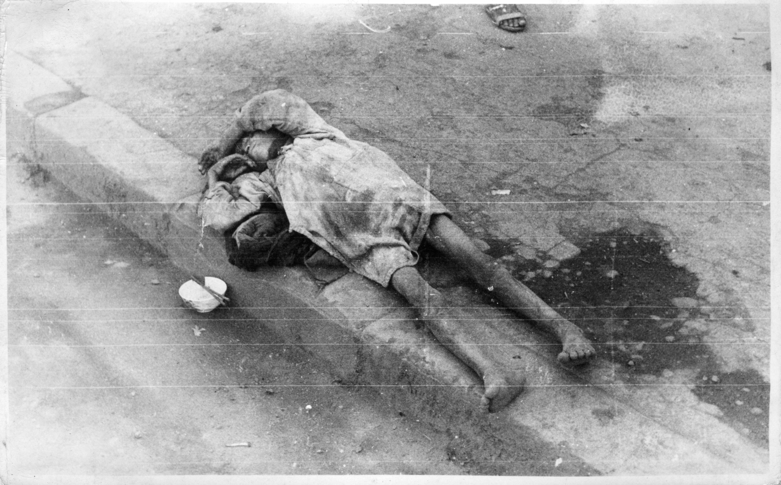
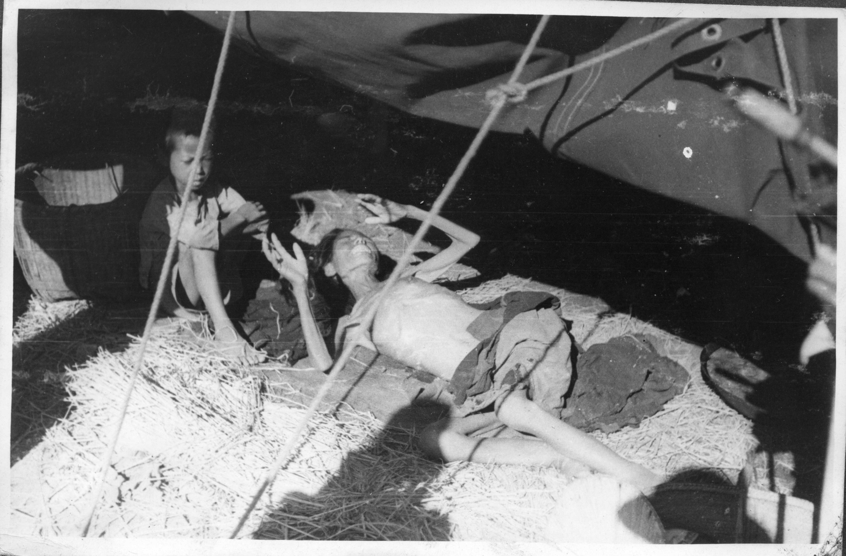
1946 Changsha

Slide 59
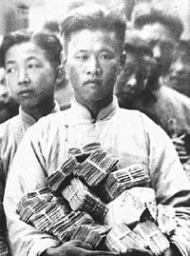
1948: Hyper-inflation in China

Slide 60
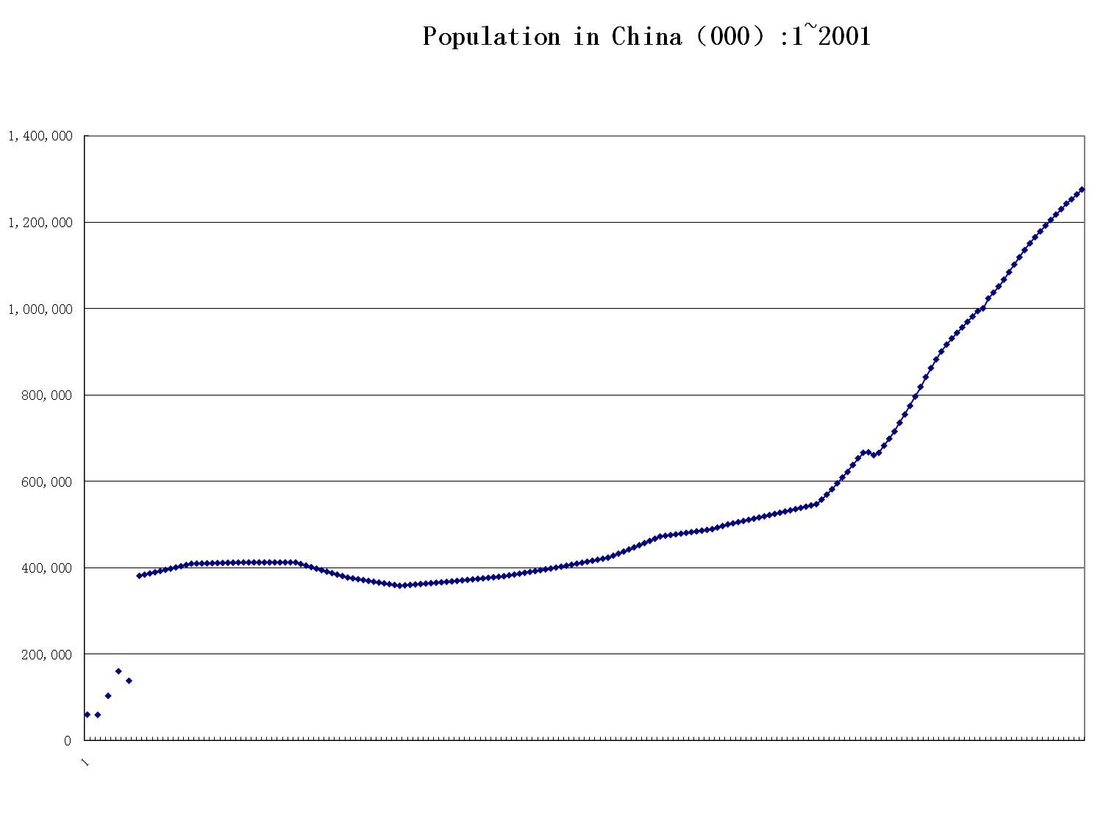
1949 was a turning point

Slide 62
The Achievements of New China 1.0
Preliminarily Industrialized the Economy
Established a Independent and Comprehensive Industrial system
GDP Growth Rate Averaged at 6.68% per year during 1953-1978
Life Expectancy increased from around 35 to about 67 years.

Slide 63
The Growth Models of New China 2.0
Evolvement of the Growth Models
Achievements
Problems

Slide 64
Evolvement of the Growth Models
Relatively
Balanced/Outward
Looking Growth
Imbalanced/outward
Looking
Balanced/Inward
Looking Growth
New growth model?
Planned Economy
With
Market Mechanism
Marketization
Privatization
Liberalization
Over-dependent
On
International Market
And
Investment
Sustainable
(Economic,
Social, Environment)
Development
1978
1992
2001
2012

Slide 65
What are the Major Reasons of Inequality in China？
Monopoly?
Corruption?
Privatization?
  Ownership ➔ Income distribution
  Ownership ➔ Labor Relation
  ➔ Income distribution
Market Economy

Slide 66
Public Enterprises’ Share in Industry Output（%）：1978-2010

Slide 67
What New Growth model Needed in the Chinese Economy?
Balanced/sustainable Economic development
  Less depend on international Market
  Less depend on Investment
  ➔Increasing Private Consumption
  ➔increasing income of the poor
  & improving the Social Security Net
  ➔(re-)nationalization of enterprises; more strictly regulated market
  Less depend on massive use of energy and resources, more environment friendly

Slide 68
Opportunities and Challenges to New Pattern
Opportunities
  The Drain Up of the Surplus Rural Labor Reserves—Lewis Turning Point
  The Foundation of Chinese Economy is Still Good (huge market, Infrastructure, Industry Clustering)
  The Current Crisis (International Market; US Model; Theory, etc)
Challenges
  The Resistance from Those Benefited Interest Groups from the Old Growth Model

Slide 69
China will still Grow fastly

Slide 70
Chinese Government still has Enough Policy Tools

Slide 71
Rapid Growth of Government Revenue and expenditure
Tr.RMB
%

Slide 72
Conclusion
China May Still Experience Rapid Growth in Future, but,
  The growth pattern has to be changed.

Slide 73
Thank You!
Questions and Comments
Welcome!
andong@tsinghua.edu.cn

