Slide 1
A Welfare-Finance Nexus and the Financial Crisis in Korea
Do-Kyun Kim
Ph.D in Sociology
Research Fellow, SNU Asia Center
edwart1@snu.ac.kr
2013. 05. 17
Notes:
Today I gonna talk about the welfare and finance in Korea.
and I wanna supplement the issues about financial development in Korea from the internal dynamics of welfare-finance nexus.

Slide 2
Ⅰ. Introduction
Household debt 1 trillion dollar
Why did households in Korea come to take on a lot of debts these days?
What implications do it have on the financial regulation and the welfare/fiscal reform?
The ‘asset-based livelihood system’ which was formed in the industrial era recently aggravates the household debt issue.
Notes:
These days the amount of household debt in Korea comes to ‘1 trillion dollar’.
It is almost the same with the size of GDP which amount to 1.2 trillion dollar.
Why did households in Korea come to take on a lot of debts these days?
What implications do it have on the financial regulation and the welfare/fiscal reform?
I would like to point out that the ‘asset-based livelihood system’ which was formed in the industrial era recently aggravates the household debt issue.
Then, what is the asset-based livelihood system?

Slide 3
Ⅱ. What is Asset-based livelihood system?
The well-known fact is that the Korean government has kept the social expenditure level very low.
Then how could Korean people survive on various social risks without public supports?
Many researches ignore that the tax burden rate has been also kept low and the household savings rate very high in Korea during the industrial era.
In fact, Korean people has desperately saved their incomes not for their enjoyment but for education, marriage, home ownership, and coping with unexpected accidents.
There existed very unique distributional setting that the government paid little money to public welfare but also could not extract so much tax from the citizen’s income. In this circumstance, household savings (or assets) functioned as a kind of livelihood measure, which the asset-based livelihood system means.
Notes:
which is what I mean by the asset-based livelihood system.
Then, where did it come from? And How was it possible?

Slide 4
Ⅲ. Asset-based livelihood system during the industrial era
As the developmental state studies point out, the Korean government was able to mobilize private saving money and allocate it through policy loans or ‘National Investment Fund’ as if it was public money.
It implies that the government had to encourage household savings through various saving campaigns and policies like ‘worker’s asset-building savings plan’ to draw up the household saving rate.
On the other hand, the combination of policy loan and savings mobilization made it possible for the state to ease the political burden of taxation.
As a result of the policy loan and savings mobilization, the livelihood system based on savings was formed.

Slide 5
Ⅲ. Asset-based livelihood system during the industrial era
“Saving is National Power”
The work of President ‘Park Jeong Hee’ to declare the ‘all-out savings year’ (1976)
Notes:
This is the work of President ‘Park Jeong Hee’ to declare the ‘all-out savings year’ which means “saving is national power”
it shows the importance of policy loan and savings mobilization during the industrial era.

Slide 6
Ⅳ. Asset-based livelihood system during the democratic transition
You could expect that the democratization changed the whole story; that was not the case.
Social policy can be very useful measure to win the electorate, but only in case of sidestepping fiscal issues like tax increasing.
In fact, both governing and opposition parties rather tended to strongly support the tax cut policy like ‘earned income tax exemption’ under the name of ‘economic democratization’ or ‘fair tax’ to gain political supports.
Furthermore, at this time, saving encouragement policy and policy loan were used to solve the housing problem, not for the industrialization.
So, a ‘2 million housing construction plan’ financially supported by the ‘National Housing Fund’ was launched to level the playing field for ‘home ownership inequality’.

Slide 7
Ⅳ. Asset-based livelihood system during the democratic transition
The change of home ownership rate
Democratization
Notes:
This graph shows that the home ownership rate was on the upturn after the democratization.
In result, whereas the level of social expenditure and tax burden were still kept very low, the dependence on household assets like housing became higher than before the democratization.

Slide 8
Ⅴ. Asset-based livelihood system after the Exchange crisis
The Exchange crisis triggered the breakdown of Korean model: the increase of labor market instability, the decrease of real income, etc.
But the growth of public welfare was so sluggish that it couldn’t cover the rapid expansion of social risks.
Therefore, in lack of labor income and transfer income, capital gains through the buoyant housing market again emerged as a way of income maintenance.
However, at this time, household assets were based on debts but not on saving. It is because, under the global financialization and the entry of foreign banks, the saving encouragement policy changed into the debt encouragement policy, especially for house purchasing.

Slide 9
Ⅴ. Asset-based livelihood system after the Exchange crisis
It is very natural that, in the circumstances of unstable employment and sluggish welfare growth, households in Korea became obsessed with a decidedly expected capital gain in buoyant housing market even if they had to borrow a huge amount of mortgage debt.
It especially pertained to the age group of over 50s who are bound to retire in the near future without any old-age security except housing.
The myth of “Real Estate never fails” dominated Korean people’s mind and home ownership functioned as the most reliable way to secure their livelihood. That is, home ownership became a ‘economic security of last resort’ in the neoliberal world.

Slide 10
Ⅴ. Asset-based livelihood system after the Exchange crisis
Composition of Household Assets (2006)
Notes:
This graph shows the composition of household assets.
We can make sure that the dependence on housing and real estate is overwhelming. It is almost 90% in total.

Slide 11
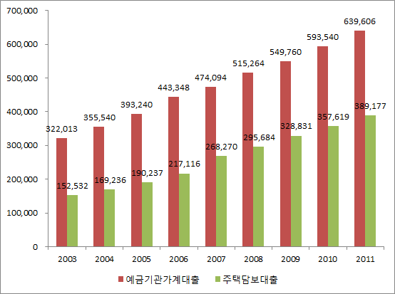
Ⅴ. Asset-based livelihood system after the Exchange crisis
Trends of household and mortgage debt by deposit banks
Household Debt
Mortgage Debt
Notes:
This graph shows a time series of total household debt and mortgage debt loaned by deposit banks.
It shows they doubled in the past decade.
In the case of household debt, it increased from 300 billion to 600 billion dollars, and in the case of mortgage, it did from 150 billion to almost 400 billion dollars.
We can find out that a considerable portion of household debt increases is accounted for by the increase of mortgage debt.

Slide 12
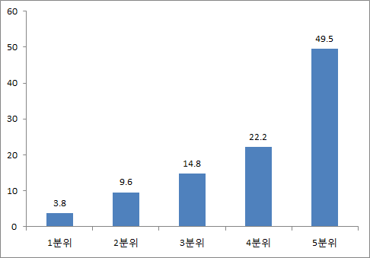
Ⅴ. Asset-based livelihood system after the Exchange crisis
Distribution of Household Debt by the Income Quintile
First Quintile Second Third Fourth Fifth Quintile
Notes:
This graph shows the distribution of household debt by the income quintile and the fourth and fifth income group account for over 70% of the household debt.
It shows that household debt in Korea is not kind of subprime mortgage but if the housing market is not recovered, korea can face with a crisis of kind of debt deflation.

Slide 13
Ⅵ. The Financial Crisis and the Financial Salvation
The housing market is in the doldrums after the Financial crisis (2008).
The downward trend in housing price is now bringing about a lot of ‘House Poor’ who are home owners in charge of repaying a huge amount of mortgage debt.
On the other hand, low income families who were forced to survive on financial debts during the economic stagnation were so vulnerable to predatory financial businesses that they came to go belly up.
In this vein, the incumbent government introduced the ‘National Happiness Fund’ to alleviate repayment burdens and help their financial recovery.
And it is again trying to boost the housing market.
Notes:
National Happiness Fund is a kind of individual bailout program usually offering long-term amortization policy to the low income families.
There is ongoing debate about the range of beneficiary. At the moment, the middle class house poor is expected to be excluded from the program
But, instead, housing market boosting program is reintroduced and it will be helpful for the house-poor.

Slide 14
Ⅵ. The Financial Crisis and the Financial Salvation
The financial industry had taken the place of the role of public finance in the past but the financialization was not accompanied with the growth of public finance or public welfare in Korea.
So, the dependence of citizen’s livelihood on finance was more strengthened in the process of financialization.
The Bank of Korea said that, as of 2011, the amount of household’s interest burdens almost comes to 5 billion dollars, which is compared to the amount of income tax which is mere 4 billion dollars.
The existence of a huge amount of household debt will tackle the attempt to expand public welfare because it is not easy to tax the debtor-citizens without solving household debt issues.
Notes:
Summing up the household’s interest and tax burden, it almost comes to 9-10 billion dollar which is an amount of being able to accomplish the universal welfare.

Slide 15
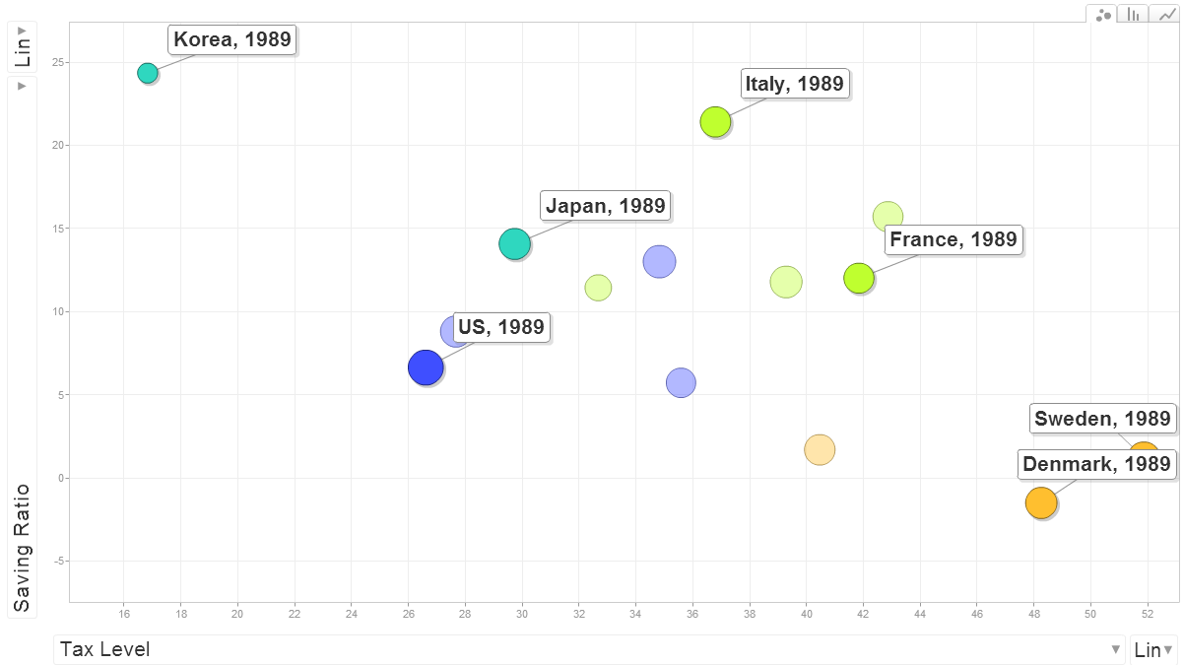
International Comparison of Tax & Saving (1989)
Notes:
This graph shows the international comparison of tax and saving in 1989.
The horizontal axis is the total tax burden and the vertical axis is the household saving rate.
Korea and Japan is located on 2 quadrant which means saving rate is high and tax burden is low.
On the contrary, Sweden and Denmark is located on 4th quadrant which means savings rate is low and tax burden is high.

Slide 16
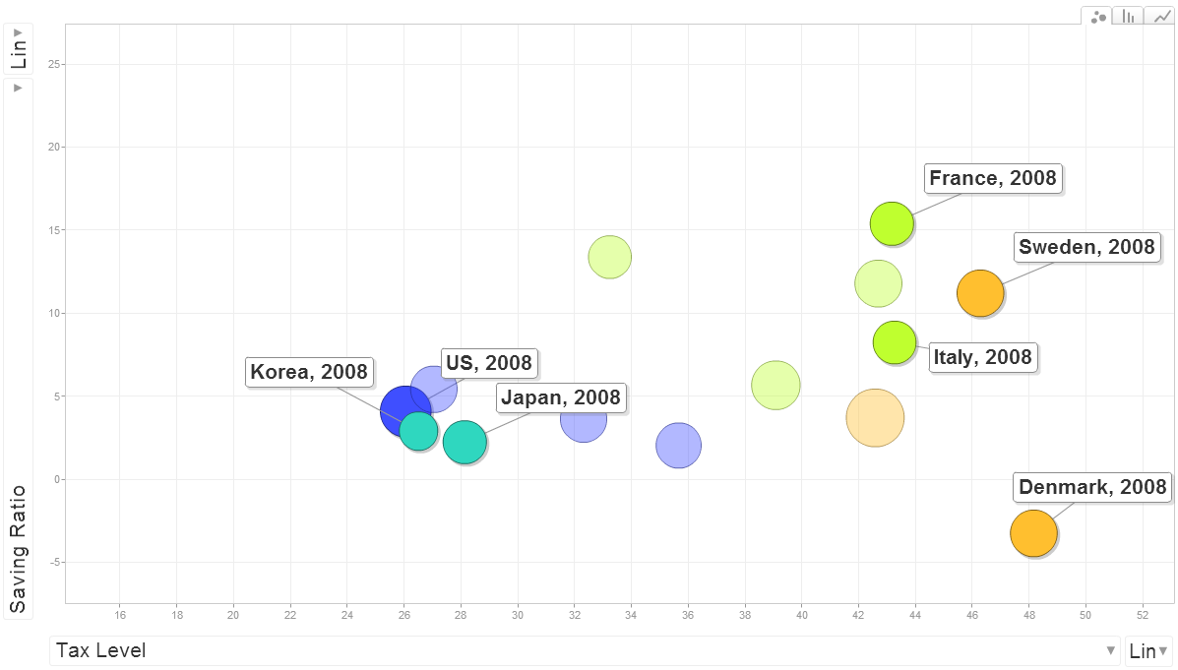
International Comparison of Tax & Saving (2008)

