Slide 1
Foreign Banks and Financial Development in Developing Countries
IDEAS Workshop, May 17, 2013
Kang-Kook Lee
College of Economics
Ritsumeikan University

Slide 2
Motivation and Background: Financial Globalization and Foreign Banks
Financial globalization has been argued to promote investment and economic efficiency, and thus economic growth
The disappointment of financial globalization is growing because of no empirical evidence for growth effects (Figure), and negative effects including financial instability and exchange rate appreciation
Foreign direct investment, especially under some preconditions, appears to be more helpful to developing countries
FDI in the financial sector with more foreign bank entry could be important to financial development and efficiency with spillover effects
But foreign bank entry may be bad to private credit because they could be involved in cream-skimming, excluding small and opaque firms from financial markets

Slide 3
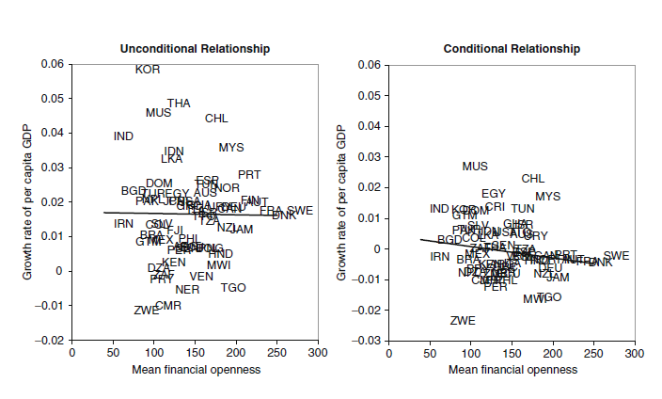
Level of Financial Globalization and Economic Growth (1985-2004)

Slide 4
Foreign Banks in Developing Countries and Their Expected Benefits
Foreign bank penetration to developing countries increased rapidly after the 1990s along with financial globalization (Figure 1, Table 1)
More financial opening of developing countries and asset diversification strategy of international banks were backgrounds
Benefits of foreign banks: efficiency and stability
Foreign banks bring advanced technology and services, promote competition and financial infrastructure, improve financial regulation and supervision
They provide more stability with diversified financial resources, while they may import and transmit external shocks across countries
Empirical studies support the efficiency effects on average, while more mixed results for the stability effects

Slide 5
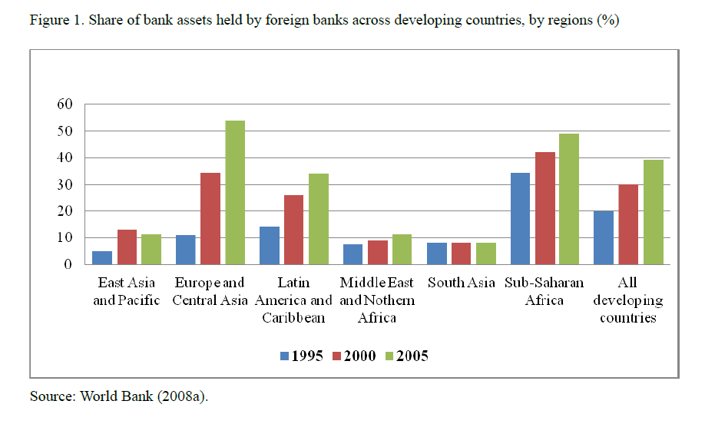

Slide 6
Foreign Banks and Financial Development: Theoretical Models
Several theoretical studies present the effects of foreign banks on private credit, using the model of banking based on information asymmetry in monitoring
Dell’Aricca and Marquez (2004): competition makes domestic banks change the loan portfolio toward borrowers whose quality is less discernible by external lenders
Sengupta (2007): foreign banks lend more to large firms while they have difficulty in lending to informationally opaque firms
Detragiache et al. (2008): foreign banks are better than domestic banks at monitoring hard information, foreign bank entry could lead to a reduction lending with serious cream-skimming
Gormely (2011): foreign banks have higher screening costs bur lower interest rates than domestic banks, lender entry with cream-skimming has the potential to create a segmented market, and reduce credit access for firms, depending on several factors

Slide 7
Foreign Banks and Financial Development: Empirical Studies
Foreign banks and private credit. Detragiache et al. (2008): negative relationship because of cream-skimming, Cull and Martinez Peria (2007): effects of banking crises since foreign banks acquired financially distressed banks, Claessens and Van Horen (2012b): negative in the mid-2000s and the global financial crisis
The lending style and segmentation of the financial market. Berger et al. (2001), Clarke et al. (2005), Mian (2006), Gormley (2010) and Haber and Musachino (2006): foreign banks lend to larger and hard information firms, negative to smaller firms, while other studies refute them, including De Haas and Naaborg (2006), Yi et al. (2009), Clarke et al. (2006) and Giannetti and Ongena (2009)
Financial access and inclusion. Detragiache et al. (2008), Sarma and Pais (2010): foreign banks entry is negative to financial access, but Beck et al. (2008a) and Beck et al. (2007) obtain different results.

Slide 8
The Empirical Test: Data and Methodology
Cross-country regressions: foreign bank entry and several aspects of financial development including private credit, cost efficiency and financial access
102 developing country sample, 1995-2005
Dependent variables: private credit/GDP, overhead costs/total assets, financial access indicators, final 5 years’ average
Foreign bank ownership in 95: the new World Bank data from Claessens al. (2008), better than former data in light of coverage
Common control variables from studies, using averages in the 90s
Methodology:
cross-sectional regressions: y_{i} = α + βfs_{i} + γX_{i} + u_{i}
growth regressions: gr_{i} = α + βfs_{i} + δ_{i} y_{i0} + γX_{i} + u_{i}
panel regressions: y_{i,t} = α + βfs_{i,t} + γX_{i,t} + δ_{i} + λ_{t} + u_{i,t}
-

Slide 9
Empirical Results: Cross-Sectional Regressions
The foreign bank share is significantly negative to private credit, controlling for the level of growth, inflation and lack of corruption, consistent with Detragiache et al. (2008) (Table 2, Figure 2)
The result is robust to using a different sample and foreign bank variables, to inclusion of other control variables such as banking crises and others (Table 3)
Bank origin matters: foreign banks from developed countries with greater geographical and cultural distance are significantly negatively associated with private credit, while those from developing countries are not (Table 4)
Threshold effects: foreign banks make more negative effects when corruption is higher, maybe due to more cream firms or too deficient lending in highly corrupt countries (Table 4)
The negative relationship between foreign banks and private credit, driven by developed country foreign banks in cross-sectional OLS

Slide 10
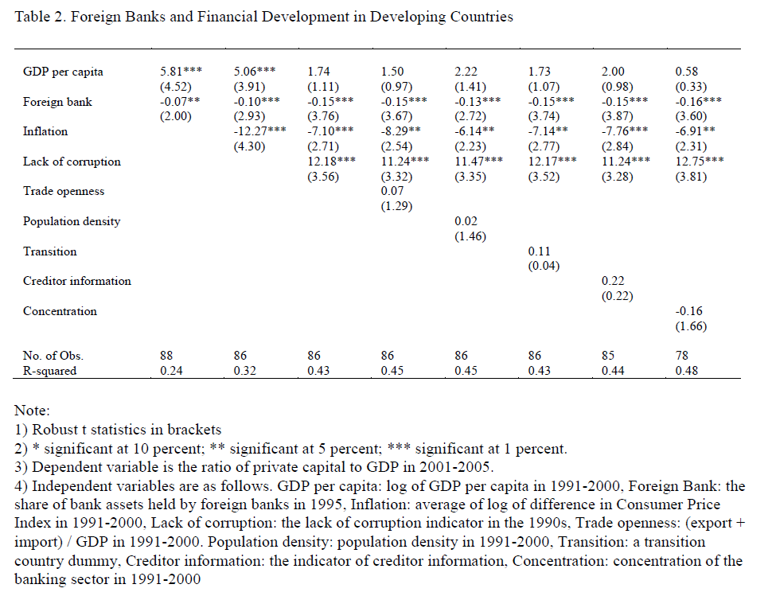

Slide 11
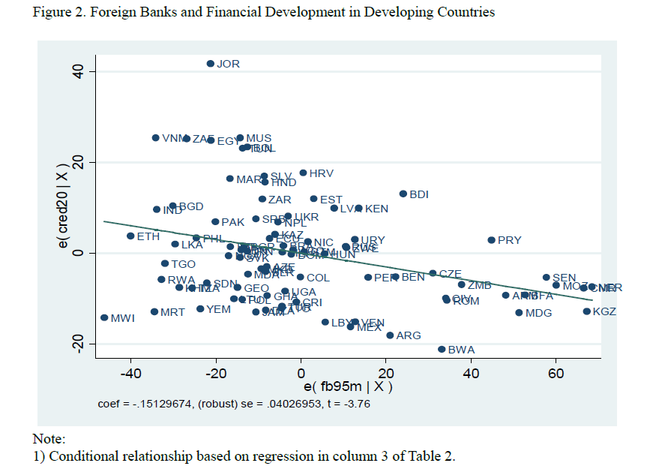

Slide 12
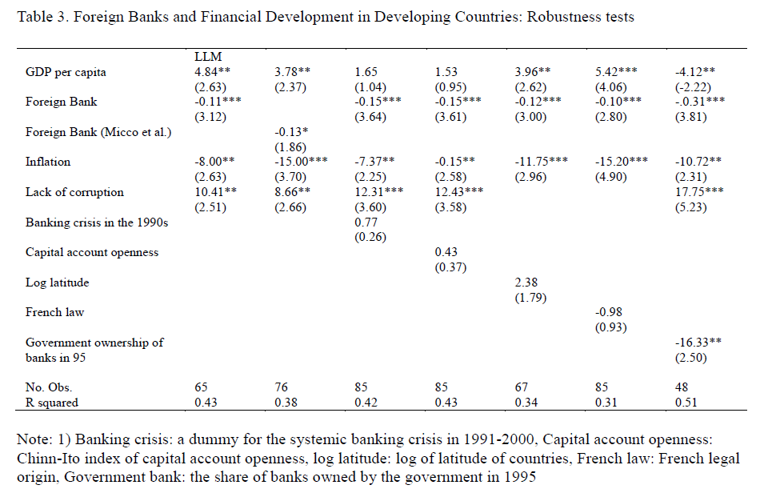

Slide 13
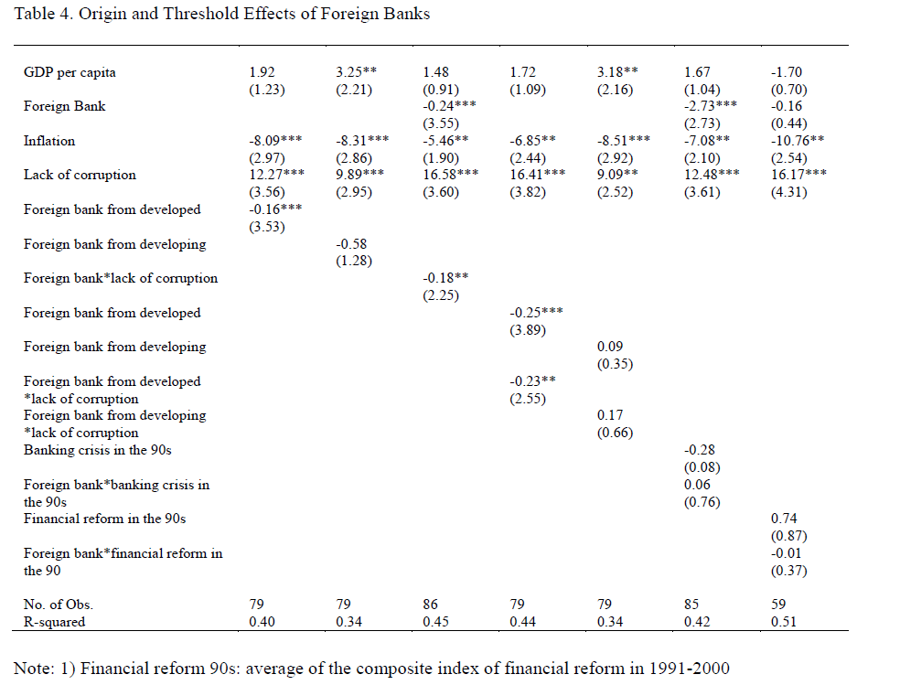

Slide 14
Empirical Results: Growth Regressions and Panel Regressions
Examining the relationship between the initial foreign bank share and the subsequent credit growth after controlling for initial private credit
Foreign bank presence is again significantly negative to the growth of private credit and the result is driven by foreign banks from developed countries, consistent with the level regressions (Table 5)
The result is robust to changes in measurement and inclusion of more control variables
Panel regressions could be better at reducing concerns of endogeneity and omitted country-specific variables, presenting short-run time-varying effects
No significant effects of foreign banks within countries in fixed effects model, but the interaction term of foreign banks and post-crisis dummy is significantly negative, similar to other study (Table 6)
No significant results in dynamic panel model, GMM model is not valid

Slide 15
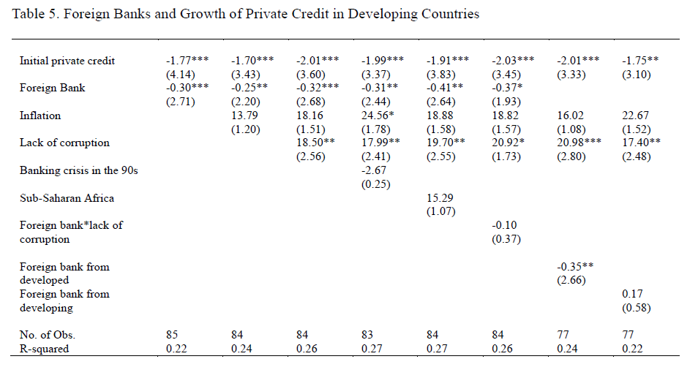

Slide 16
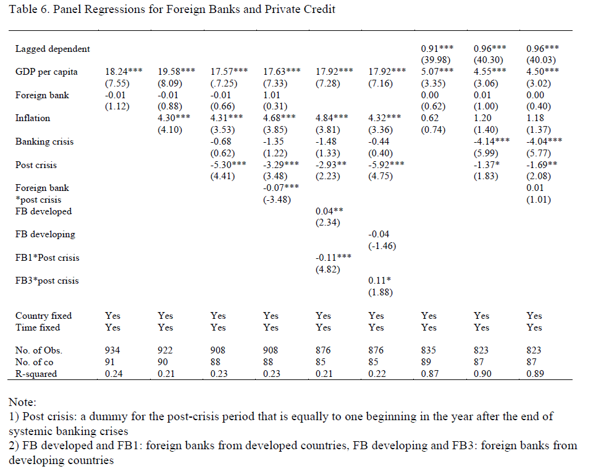

Slide 17
Empirical Results: Financial Efficiency and Financial Access
The foreign bank share is positively associated with bank overhead costs, controlling for inflation and population density, in OLS cross-sectional regressions (Table 7)
The higher foreign bank presence, from both developed and developing countries, makes the banking sector less cost-efficient
Panel regressions show that GDP per capita and concentration significant, and foreign banks from different origin have different signs in fixed effects model, while 2-step GMM estimator in dynamic panel presents consistent result with that from OLS (Table 8)
No significant effects of foreign banks on financial access using various indicators including the composite index for financial access and geographical and demographical penetration, different from Detragiache et al. (2008)

Slide 18
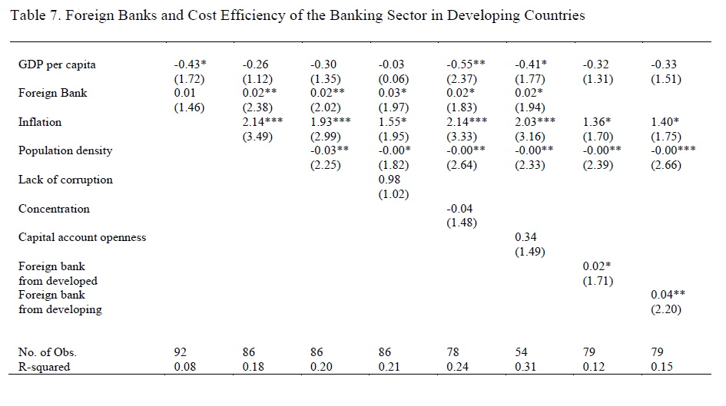

Slide 19
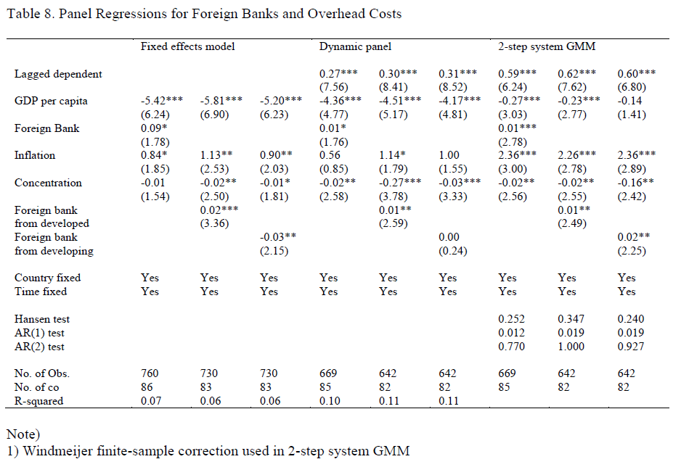

Slide 20
Conclusions
This study empirically examines the relationship between foreign banks and several aspects of financial development including financial depth, cost efficiency and financial access
We find that the higher foreign bank presence is negatively associated with private credit and cost efficiency of the banking sector, in line with the disappointment of financial globalization
Foreign banks from developed countries exert negative effects on private credit, while those from developing countries do not
Threshold effects should be examined more extensively to think of policy suggestions, especially in a broader context of the development strategy
More detailed case studies are called on to overcome limitation of cross-country regressions

Slide 21
Foreign Banks in Asian Developing Countries
In general, the share of foreign banks is low, compared with other regions because of relatively stronger regulation and capital controls (Figure)
Relatively high financial development in East Asia, while mediocre financial development in South Asia
Economic growth in the Asian region has been higher and more stable than that of other developing countries, which might be related with the small role of foreign banks
Empirical studies report that benefits of foreign banks in Asia are not so evident in comparison with other regions
However, a few East Asian countries went through rapid financial opening and the financial crisis, and more financial globalization
More studies on foreign banks and regulation are called together with regional financial cooperation

Slide 22
The share of foreign bank in total bank assets

Slide 23
Foreign Banks in Korea
There was a significant increase in the share of foreign banks in Korea after the 1997 financial crisis and more financial opening following the crisis (Figure)
The share of foreign banks is much higher than other Asian countries, comparable to Latin America and Eastern Europe.
Hot debates on the role of foreign banks in Korea is going on
- Positive: better management skills and technology, competition effects, and pressure on corporate governance
- Negative: conservative and short-term profit oriented, rapid reduction of corporate lending, especially for small and medium enterprises by foreign-owned banks, more increase in household lending, and difficulty of the government policy
More discussions on external financial regulation are necessary after the global financial crisis

Slide 24
The share and number of foreign bank in Korea

