Slide 1
Financial Regulatory Debates around the Globe and in India
T. Sabri Öncü
Center for Advanced Financial Research and Learning
Mumbai, India

Slide 2
Important Ongoing Debates
I. What is “systemic risk”?
How should we contain systemic risk when it arises?
II. Will systemic risk simply move to “shadow banks”?
How should we regulate “shadow banking”?

Slide 3
What is “systemic risk”?
Micro-prudential view: Contagion
Failure of an entity leads to distress or failures of others
Too-big-to-fail institutions
Regulate TBTF better
Systemically Important Financial Institutions (SIFIs)
Regulate SIFIs better

Slide 4
What is “systemic risk”?
Macro-prudential view:
(Diamond-Dybvig 1983 + Shleifer-Vishny 1992)
Common factor exposures
Runs
Several entities fail together as
Short-term creditors demand immediacy
Against long-term assets
But the system has limited capacity (capital?) to provide immediacy
The micro-prudential and macro-prudential views are not necessarily mutually exclusive

Slide 5
What is Shadow Banking?
2007/McCulley: Shadow banking is the whole alphabet soup of levered up nonbank investment conduits, vehicles, and structures.
2010/Acharya and Öncü: A shadow bank is a nonbank financial institution that behaves like a bank, borrows short-term in rollover debt markets, leverages itself significantly, and lends and invests in longer-term in illiquid assets. Unlike banks, however, the shadow banks are much less regulated.
2010/Adrian et al: Shadow banks are financial intermediaries that conduct maturity, credit, and liquidity transformation without explicit access to central bank liquidity or public sector credit guarantees.
2012/Ghosh et al: Shadow banking comprises a set of activities, markets, contracts, and institutions that operate partially (or fully) outside the traditional commercial banking sector, and, as such, are either lightly regulated or not regulated at all. The distinguishing feature of shadow banking is that it decomposes the process of credit intermediation into a sequence of discrete operations. . A shadow banking system can be composed of a single entity that intermediates between end-suppliers and end-borrowers of funds, or it could involve multiple entities forming a chain.

Slide 6
What is Shadow Banking?
Key points:
Any shadow banking system conducts maturity, credit and liquidity transformation outside the traditional banking system. Thus, not only it is less regulated than the traditional banking system or not regulated at all, but also there is no explicit access to central bank liquidity or public sector credit guarantees.
Since any shadow banking system decomposes the process of credit intermediation into a sequence of discrete operations, it can be a collection not only of single financial entities acting independently, but also of (and usually is) networks of multiple financial entities acting together or both: banks, formal and informal nonbank financial institutions, and even credit rating agencies, regulators and governments.
Any shadow banking system is highly levered. Further, while its assets are risky and illiquid, its liabilities are prone to “bank runs”.

Slide 7
Sabotage
Sabotage, “the strategy of delay, restriction, hindrance and defeat”, “has to do with something in the nature of vested right” and “of vested interest.”
“So long as the system remains unchanged”, sabotage is a “necessary and legitimate part of it.”
Veblen (1921)
“We make profits, not steel.”
Edgar B. Speer (1973)
CEO, US Steel, 1973-1976

Slide 8
Sabotage to Loot
“Our theoretical analysis shows that an economic underground can come to life if firms have an incentive to go broke for profit at society’s expense (to loot) instead of to go for broke (to gamble on success). Bankruptcy for profit will occur if poor accounting, lax regulation, or low penalties for abuse give owners an incentive to pay themselves more than their firms are worth and then default on their debt obligations.”
Akerlof and Romer (1993)
“I would do anything to make money.”
Bernard (1997)

Slide 9
Normal versus Fat-tailed Distributions Tail Risk

Slide 10
Manufacturing Tail Risk Sabotage to Loot
Depository Institutions Deregulation and Monetary Control Act (1980)
introduced two classes of capital: primary (core) and secondary (fictitious)
Basel I (1988 – 1992)
introduced risk weighted assets – bank assets were classified into five risk categories, carrying risk weights of zero, ten, twenty, fifty, and one hundred percent (credit default swaps were a response of the financial sector); reintroduced two classes of capital: tier 1/primary (core) and tier 2/secondary (fictitious)
Financial Services Modernization Act (1999)
removed barriers among banking companies, securities companies and insurance companies that prohibited any one institution from acting as any combination of an investment bank, a commercial bank, and an insurance company
Commodity Futures Modernization Act (2000)
ensured deregulation of the over-the-counter (OTC) derivatives
Bankruptcy Abuse Prevention and Consumer Protection Act (2005)
“safe harbor” treatment in bankruptcy extended to forward contracts, commodity contracts, repurchase agreements and securities contracts

Slide 11
Manufacturing Tail Risk IMF Global Financial Stability Report 2008

Slide 12
Manufacturing Tail Risk Growth of the Over-the-Counter Derivatives

Slide 13
Manufacturing Tail Risk Consumer Debt Growth

Slide 14
Manufacturing Tail Risk When Banking was Boring
Bank Balance Sheet
Assets
Liabilities
Loans
Deposits
Capital

Slide 15
Manufacturing Tail Risk When Banking was Still Boring: Securitization
Bank Balance Sheet
Assets
Liabilities
Loans
Deposits
Capital
Special Purpose Vehicle
Assets
Liabilities
Loans
Equity (Asset-Backed Securities)

Slide 16
Manufacturing Tail Risk Banking gets Exciting – First Kind
Bank Balance Sheet
Assets
Liabilities
Loans
Deposits
Capital
Guarantees
Conduit
Assets
Liabilities
Loans
Debt (Asset-Backed Commercial Paper)

Slide 17
Manufacturing Tail Risk Banking gets Exciting – Second Kind
Bank Balance Sheet
Assets
Liabilities
Loans
Deposits
Capital
Credit Rating Agencies
Special Purpose Vehicle
AAA
BB
NR
Assets
Liabilities
Loans
Asset-Backed Securities

Slide 18
Manufacturing Tail Risk Banking gets Exciting – Third Kind
Bank Balance Sheet
Assets
Liabilities
Deposits
Credit Default Swaps
+
Guarantees
Loans
Capital
Fannie Mae - Freddy Mac
AIG
Bond Insurers
Special Purpose Vehicle
Assets
Liabilities
Loans
Asset-Backed Securities

Slide 19
A ROUGH MAP OF THE INDIAN CREDIT SYSTEM

Slide 20
Banks of India
Regulator: Reserve Bank of India
Commercial Banks
Cooperative Banks
Public Banks
Private Banks
Foreign Banks (36)
Urban Cooperative Banks
State Bank of India and Associate Banks (6)
Old Private Banks (14)
State Cooperative Banks
Nationalized Banks (20)
New Private Banks (7)
Regional Rural Banks (82)

Slide 21
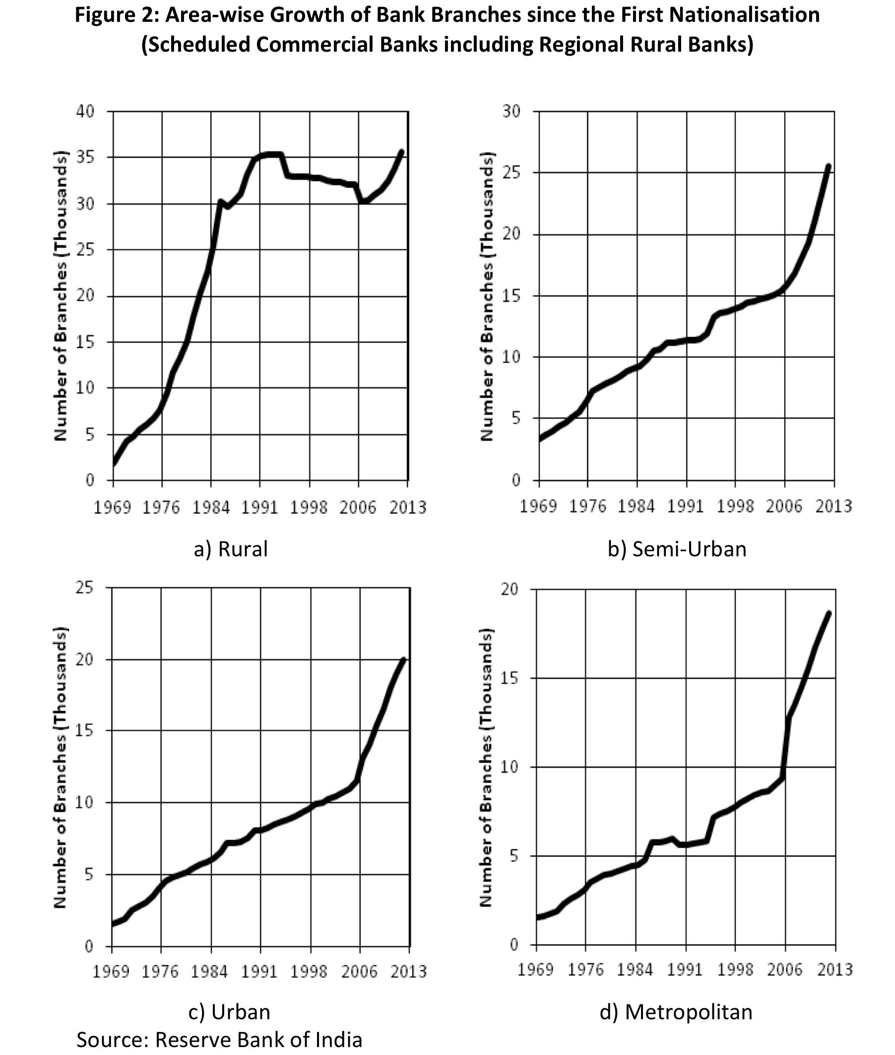

Slide 22
Nonbank Financial Institutions of India
(NBFIs)
Nonbank Financial Companies
(NBFCs)
All India (Public) Financial Institutions:
Export Import Bank (Exim Bank)
National Bank for Agricultural and Rural Development (NABARD)
National Housing Bank (NHB)
Small Industries Development Bank of India (SIDBI)
Life Insurance Corporation (LIC)
Etc.
Nonbank Financial Companies
(NBFCs)
Insurance Regulatory and Development Authority Regulated
Government Regulated
Reserve Bank of India Regulated
Securities and Exchange Board of India Regulated
National Housing Bank
Regulated
Insurance Companies
Housing Finance Companies
Government Regulated NBFCs
Mutual Benefit Companies
(Potential Nidhis)
Mutual Benefit Financial Companies
(Notified Nidhis)
Miscellaneous NBFCs
(Chit Funds)
Securities and Exchange Board of India Regulated NBFCs
Stock Exchanges
Stock Brokers
Merchant Banks
Mutual Funds

Slide 23
Reserve Bank of India Regulated NBFCs
Tightly Regulated/Monitored
Loosely Regulated/Monitored
Deposit taking
Non-deposit Taking – Systemically Important
All other NBFCs including Microfinance Institutions
Asset Finance Company
Asset Finance Company
Loan Company
Loan Company
Investment Company
Investment Company
Residual NBFCs
Core Investment Company
Infrastructure Finance Company

Slide 24
Informal Financial Institutions of India
Registered
Unregistered/Illegal
General Financiers
General Financiers
Badla (stock trading) Financers
Daily/Weekly/Monthly Financiers
Commodity Trade Financiers
Commodity Trade Financiers
Vendor Financers
Fast Moving Consumer Good Financiers
Pawn Brokers
Pawn Brokers
Plantation Companies
Plantation Companies
Gold Loan Companies
Gold Savings Schemes
Pyramid Schemes
Pyramid Schemes
Chit Funds

Slide 25
Is Reregulating Finance the Solution?
“So long as the system remains unchanged”, sabotage is a “necessary and legitimate part of it.”
Veblen (1921)

