Slide 1
Financialisation and Industry Diverse Regional Responses to the Global Crisis: Implications for Finance and the Real Economy Muttukadu Chennai Jan 2015
Sushil Khanna
Indian Institute of Management Calcutta

Slide 2
Finance & Global Economy: Some Issues That Have Vexed Us
What has fueled the expansion of financial sector in the Western World ?
What are the key characteristics of the contemporary financial sector?
What is the mode of surplus appropriation?
How does this financialisation of economy change our understanding of contemporary capitalism?
What does it mean for developing economies?

Slide 3
Making of a New Regime of Financial Accumulation 1973-1989
End of fixed exchange rates and expansion of trading / speculation in foreign exchange markets
Globalization of finance (initially limited to TRIAD and later to few developing countries)
Erosion of Glass – Steagall restrictions and rise of “self-regulation”
Mergers & rise of financial conglomerates
Universal banking

Slide 4
Financialisation
Monetarist policies that used interest rates to control inflation destroyed funding ability of banks and “thrift” industry
Key role of Securitisation ( “financial paper suitable for global structure” - Minsky)
Enhanced the funding capability of financial market -- as opposed to banks
Conformity of Institutions across nations- “ability of creditors to capture assets that underlie securities”(L. American Debt Crisis)

Slide 5
Financialisation
This was accompanied by capital account liberalisation and globalisation of production and trade
Western oligopolies increasingly under pressure from Third World producers
Financial sector begins to grow at rates twice as fast as real economy – sometimes unconnected to real economy

Slide 6
Financialisation of US / UK Economies
Rising share of Financial Sector in GDP, Employment, but most important in Profit share in economy
Financialisation of Non-Financial Firms
Increasingly Non Financial Firms (Manufacturing / services) invest in finanial markets

Slide 7
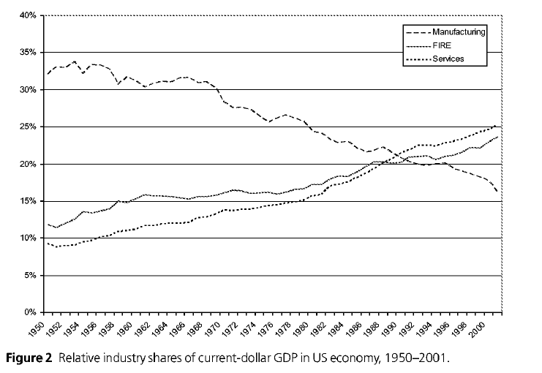
Rising share of FIRE in USA GDP

Slide 8
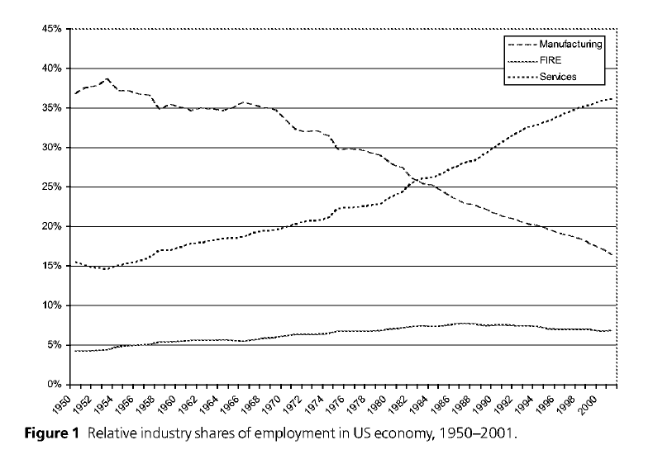
Share of Employemt

Slide 9
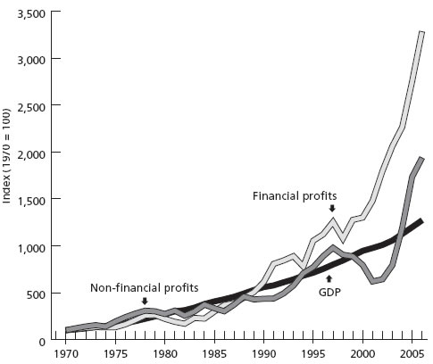
Increasing share of financial profits (Index 100=1970)

Slide 10
Finance Today -- Speculative ?
We now know that Financial System no longer serves need of production /real economy
Only 3 per cent of the UK’s £ 6 trillion (= £200 bn) financial sector’s assets constitute lending to business (manufacturing, retail, transport etc)
Consumer loans & mortgages = £ 1000 bn
Rest ( 82 per cent) are all financial assets

Slide 11
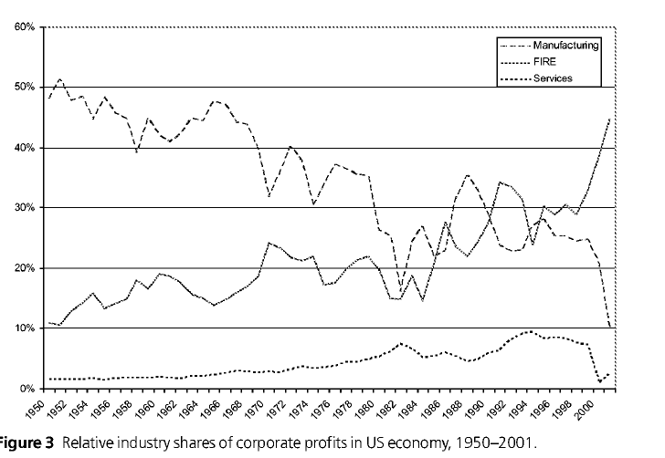
Changing share of corporate profits-US

Slide 12
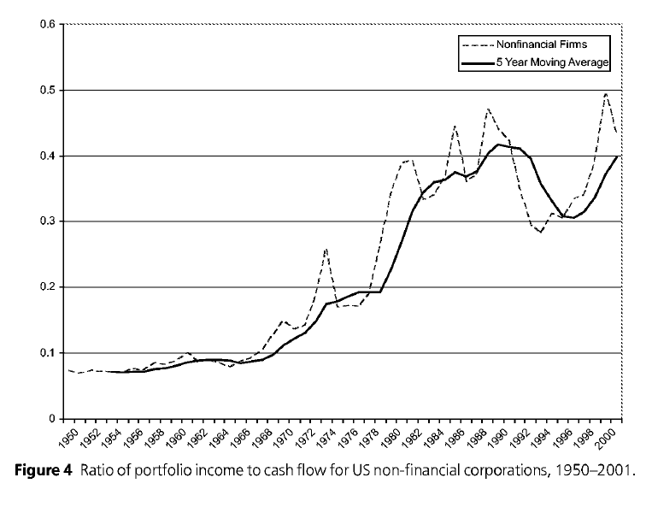

Slide 13
Shift in power to Financial Oligarchy
“ while .. these entities( boardrooms of giant multinationals) … (control) allocation of resources…. the occupants of these boardrooms are themselves to an increasing extent constrained and controlled by finance capital” (Paul Sweezy, 1994)

Slide 14
Financial Liberalisation in India
Capital account convertibility to prop-up a growing financial sector held back by
Narasimham – I 1997-98
Narasimham – 2 2006
Restricted use of derivatives
Still India has incipient financial liberalisation and entry of private equity and hedge funds with rising conflict with promoters.

Slide 15
Indian Financial Sector
Yet Capital Market and Banking Deregulation Core policy of all governments
Expansion of capital markets and destruction of industrial development banks.
Privatisation and shift in favour of corporate power

Slide 16
Indian Accumulation Regime
Year | Household Sector |  | Private Corp Sector |  | Public Sector
 | Savings | GCF | Savings | GCF | Savings | GCF
70-71 | 66,52 | 41,60 | 10,23 | 15,35 | 23,25 | 43,05
80-81 | 69,66 | 37,51 | 8,70 | 14,30 | 21,64 | 48,19
90-91 | 80,60 | 40,08 | 11,66 | 18,59 | 7,74 | 41,33
95-96 | 69,08 | 30,07 | 20,33 | 39,09 | 10,60 | 30,84
08-09 | 69,63 | 34,27 | 25,96 | 35,70 | 4,42 | 26,42

Slide 17
Changing Nature of Corporate Finance in India
Last 25 years have seen significant changes in financing of Indian private corporate sector
Firstly, there has been destruction of three large Industrial development banks that supported private industrial projects
Secondly, the Private Corporate Profits have become significant and about 25 % of total national savings (still rising)

Slide 18
Changing Nature of Corporate Finance in India
Thirdly, the State has deliberately pushed corporate sector towards capital markets for long term funds, -- both equity and later bond market, as well encouraged banks to enter securitized debt market – commercial paper, securitized corporate bond market etc.

Slide 19
Corporate Profits and accumulation

Slide 20
Our Investigation
We look at Non – Financial Corporate Sector to understand changing nature of corporate finance

Slide 21
Data set
All the ratios are based on data set extracted from Prowess data base maintained by Centre for Monitoring Indian Economy Pvt. Ltd. (CMIE)
Data is extracted between years 1992-93 and 2012-13.
It includes 1138 companies which are common across all years.

Slide 22
Debt Equity ratio of Private Corporate sector
Source: Based on RBI data on public limited companies

Slide 24
Ratio of change in internal and external funds to change in gross fixed assets

Slide 25
Ratio of change in internal and external funds to Total Investment (change in GFA + financial investments)

Slide 28
Tata Cross Investment: 1991-2007
(Rs. Crore) | 1991 | 1995 | 2000 | 2005 | 2007
No. of Cos. | 57.00 | 68.00 | 103.00 | 108.00 | 82.00
Inc_revenue_total | 10367.77 | 24349.51 | 42770.60 | 83360.73 | 114538.17
Total_assets | 11694.44 | 30085.65 | 64291.05 | 103907.32 | 152477.41
Investments | 1462.42 | 2985.47 | 11279.66 | 31113.62 | 44886.11
Invest_equity_shares | 391.65 | 1922.40 | 7985.45 | 21819.55 | 33099.06
Invest_group_equity | 289.00 | 1633.42 | 5516.54 | 21133.46 | 32628.25
Invest_prefence_shares | 0.00 | 4.70 | 252.93 | 898.37 | 1296.39
Invest_group_preference | 0.00 | 0.00 | 99.76 | 858.96 | 1268.74
Invest_all_debt_instru | 204.69 | 293.33 | 270.17 | 2228.52 | 2825.01
Invest_group_debt_instru | 0.00 | 0.00 | 2.68 | 170.17 | 428.63
Invest_mutual_fund | 860.57 | 743.07 | 1344.73 | 6399.45 | 7671.00
Invest_group_mutual | 0.00 | 0.00 | 120.46 | 1156.69 | 2320.22
Total_quoted_investment | 242.90 | 1355.20 | 5068.28 | 10756.46 | 13477.28
Quoted_group_cos | 0.00 | 161.86 | 2897.57 | 8500.24 | 12002.12
Mkt_value_quoted_invest | 807.33 | 5048.25 | 3984.27 | 82643.31 | 133861.19
Investment_abroad | 0.00 | 0.00 | 215.66 | 1835.46 | 7191.13
Invest_abroad_group | 0.00 | 0.00 | 90.61 | 1821.95 | 7187.57
Total Cross Investment | 289.00 | 1633.42 | 5739.44 | 23319.28 | 36645.84
Cross Investment/ Total Asset | 0.025 | 0.054 | 0.089 | 0.224 | 0.240
* This is by adding all the group companies Source: Our dataset compiled from CMIE

Slide 29
Aditya Birla Cross Investment: 1991-2007
(Rs. Crore) | 1991 | 1995 | 2000 | 2005 | 2007
No. of Cos. | 18 | 23 | 32 | 46 | 40
Inc_revenue_total | 3883.67 | 7108.39 | 13623.78 | 28642.76 | 48377.41
Total_assets | 4452.82 | 11561.10 | 22303.89 | 38460.33 | 64081.66
Investments | 747.86 | 2828.96 | 2642.51 | 9261.31 | 18976.79
Invest_equity_shares | 91.58 | 531.54 | 1723.48 | 5266.38 | 8450.61
Invest_group_equity | 7.14 | 438.07 | 1051.81 | 5046.27 | 8283.27
Invest_prefence_shares | 0.00 | 0.00 | 55.35 | 272.75 | 368.17
Invest_group_preference | 0.00 | 0.00 | 54.95 | 17.04 | 23.66
Invest_all_debt_instru | 208.32 | 370.91 | 333.96 | 82.67 | 200.86
Invest_group_debt_instru | 0.00 | 0.00 | 9.70 | 44.53 | 65.70
Invest_mutual_fund | 443.65 | 1868.79 | 499.08 | 3753.22 | 9490.74
Invest_group_mutual | 0.00 | 0.00 | 86.52 | 3753.22 | 112.02
Total_quoted_investment | 4.32 | 2159.48 | 1298.29 | 2826.34 | 13696.02
Quoted_group_cos | 0.00 | 0.00 | 469.84 | 2617.94 | 6044.57
Mkt_value_quoted_invest | 5.76 | 3079.29 | 1059.94 | 4142.64 | 28438.46
Investment_abroad | 0.00 | 0.00 | 26.62 | 480.09 | 705.78
Invest_abroad_group | 0.00 | 0.00 | 0.00 | 462.02 | 686.03
Total Cross Investment | 7.14 | 438.07 | 1202.98 | 8861.06 | 8484.65
Cross Investment/ Total Asset | 0.002 | 0.038 | 0.054 | 0.230 | 0.132
* This is by adding all the group companies Source: Our dataset compiled from CMIE

Slide 30
Other Business Groups (Selected):
Mafatlal, Murugappa & Thapar
(Rs. Crore) | 1991 | 1995 | 2000 | 2005 | 2007
ARVIND MAFATLAL GROUP
Total Assets | 1589.02 | 3351.73 | 3588.5 | 1867.74 | 1901.01
Total Investments | 97.05 | 680.94 | 646.02 | 381.08 | 377.9
Total Cross Investment | 8.69 | 380.33 | 485.47 | 373.44 | 354.72
Cross Investment/ Total Assets | 0.005 | 0.113 | 0.135 | 0.199 | 0.186
MURUGAPPA GROUP
Total Assets | 1178.33 | 2494.75 | 4580.44 | 6641.65 | 10668.38
Total Investments | 85.58 | 284.59 | 415.1 | 785.79 | 825.71
Total Cross Investment | 8.16 | 104.61 | 110.83 | 686.97 | 683.09
Cross Investment/ Total Assets | 0.006 | 0.0419 | 0.0242 | 0.103 | 0.064
THAPAR GROUP
Total Assets | 2576.2 | 5807.62 | 9557.95 | 9125.2 | 10046.29
Total Investments | 88.69 | 523.6 | 869.38 | 1465.22 | 1588.83
Total Cross Investment | 44.39 | 283.85 | 699.34 | 1117.88 | 1263.55
Cross Investment/ Total Assets | 0.017 | 0.049 | 0.073 | 0.123 | 0.126
* This is by adding all the group companies Source: Our dataset compiled from CMIE

Slide 33
In Conclusion
Can developing countries play a role in redefining the role of finance?
State owned banks and financial entities?

